Slide 1
Adapting Language Models
[Slide credit: Iz Beltagy, Arman Cohan, Robert Logan IV, Sewon Min, Sameer Singh, and many others ]
CSCI 601-471/671 (NLP: Self-Supervised Models)
https://self-supervised.cs.jhu.edu/sp2025/

Slide 2
Logistics update
Quiz 2 is this Thursday.
Will cover everything until the beginning of “LM adaptation”.
Grade distributions so far are online on Piazza.

Slide 3
Adapting Language Models: Chapter Plan
You have a pre-trained language model that is pre-trained on massive amounts of data.
They do not necessarily do useful things—they only complete sentences.
Now how to you ”adapt” them for your use-case?
Prompting: adapting model inputs (language statements)
Tuning: adapting (modifying) model parameters

Slide 4
Adapting Language Models: Chapter Plan
Adaptation via Fine-tuning
Parameter-efficient fine-tuning
Adaptation via In-Context Learning
In-context learning of multi-step problems.
Chapter goal: Get comfortable with various forms of adapting LMs for solving your tasks!

Slide 5
Adaptation via Fine-Tuning

Slide 6


Fine-Tuning for Tasks
The cat is
cute
o gato é fofo
DET N VB ADJ
positive
layer2
layer2
layer2
layer2
layer1
layer1
layer1
layer1
<s> The cat is cute
The cat is cute
The cat is cute
[CLS] The cat is cute
Language modeling
Translation
POS Tagging
Text classification
Our focus
Model with
random weights
Pretraining
Adaptation and Alignment
High-utility model (general-purpose or specialized)
Pretrained
model
(Large but unlabeled data)
(smaller but labeled data)

Slide 7
Fine-tuning Pre-trained Models
Classiﬁcation
Head
Whole model tuning:
Run an optimization defined on your task data that updates all model parameters
Head-tuning:
Run an optimization defined on your task data that updates the parameters of the model “head”
Positive
Negative
Language
Model
Embeddings
Input
[CLS] A three-hour cinema master class.
[ACL 2022 Tutorial Beltagy, Cohan, Logan IV, Min and Singh]

Slide 8
Fine-tuning Pre-trained Models
In fine-tuning we need to updating and storing all the parameters of the LM
We would need to store a copy of the LM for each task
With large models, storage management becomes difficult
E.g., A model of size 170B parameters requires ~340Gb of storage
If you fine-tune a separate model for 100 tasks:
340 * 100 = 34 TB of storage!

Slide 9
Why Parameter-efficient fine-tuning?
Decreased computational and storage costs:
Up to x1000 less parameters needed. You can store many checkpoints and tasks
Overcoming catastrophic forgetting: During full fine-tuning of LLMs, catastrophic forgetting can occur where the model forgets the knowledge it learned during pretraining.
Better performance in low-data regimes: PEFT performs better than full fine-tuning in low-data regimes and generalizes better to out-of-domain scenarios.
Portability: The trained weights from PEFT approaches are easy to deploy and use for multiple tasks without replacing the entire model. Ability to store many checkpoints and many tasks
Performance comparable to full fine-tuning

Slide 10
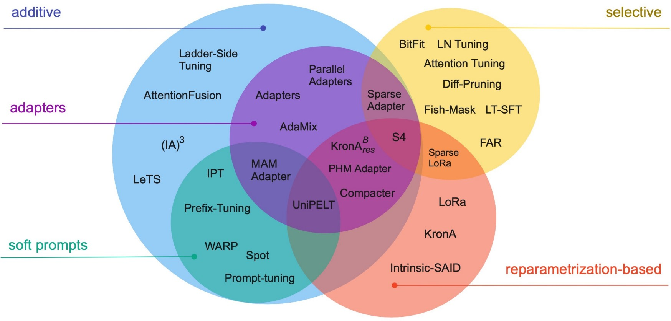
Parameter-efficient Fine-tuning
fig source https://arxiv.org/pdf/2303.15647.pdf

Slide 11
Param-efficient Tuning: Additive Models
Augmenting the existing pre-trained model with extra parameters or layers and training only the new parameters
Two commonly used methods:
Soft prompts
Adapters

Slide 12

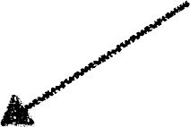

Prompt tuning (Soft Prompts)
output
the
mat was soft <s> <p>
LM
continue the sentence
the
cat
sat
on
the
mat
prompt
input
[Slide: Arman Cohan]

Slide 13



Prompt tuning (Soft Prompts)
output
the
mat was soft <s> <p>
LM
continue the sentence
the
cat
sat
on
the
mat
prompt
input
• Designing good prompts might be difficult for each task
• Maybe we can “learn” the prompts?
[Slide: Arman Cohan]

Slide 14
Prompt tuning (Soft Prompts)
output
the
mat was soft <s> <p>
LM
x1
x2
x3
x4
x5
the
cat
sat
on
the
mat
soft (trainable) prompts
input
• Designing good prompts might be difficult for each task
• Maybe we can “learn” the prompts?
[Slide: Arman Cohan]

Slide 15
Prompt tuning (Soft Prompts)
output
the
mat was soft <s> <p>
FROZEN
not trained
only the model’s input embeddings is fine-tuned via gradient descent.
LM
x1
x2
x3
x4
x5
the
cat
sat
on
the
mat
soft (trainable) prompts
input
It is better to initialize soft prompts from existing vocab than randomly. [Lester et al., 2021]

Slide 16
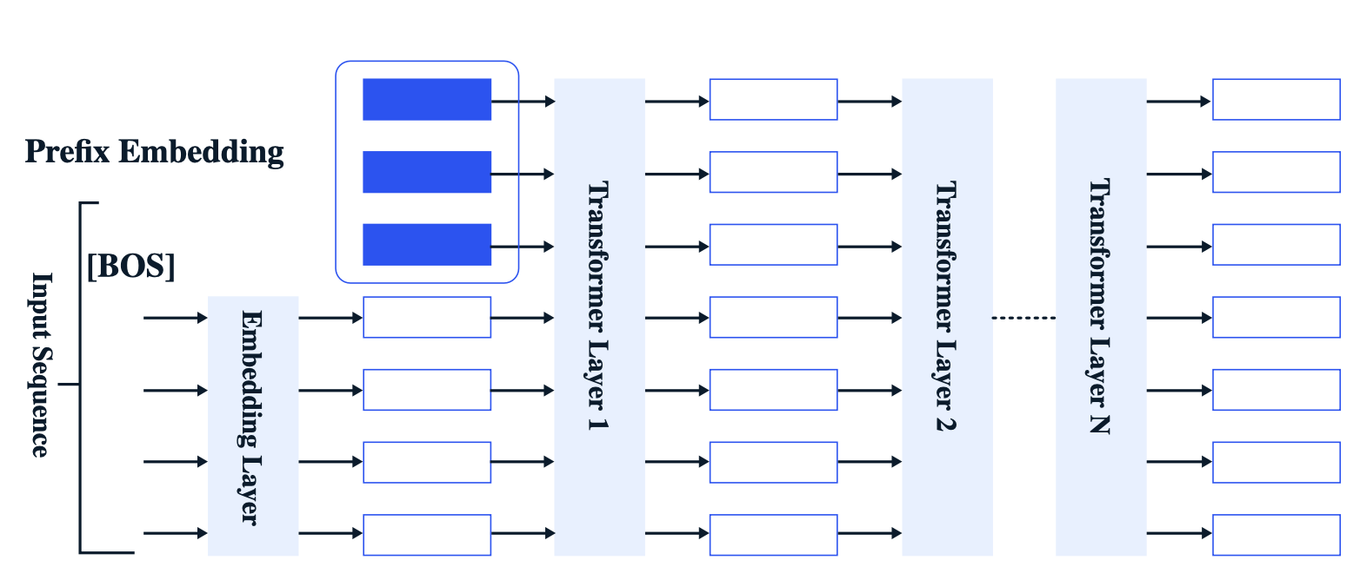
Prompt tuning (Soft Prompts)
[Slide credit: Samet Oymak]

Slide 17
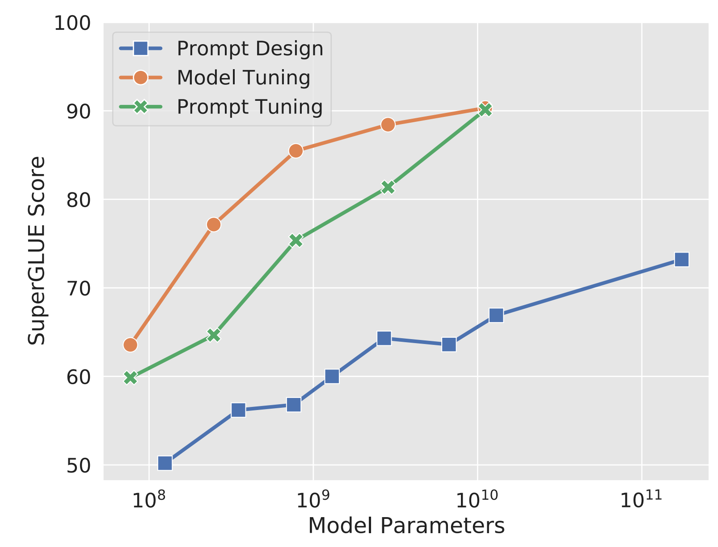
Prompt Tuning: Effect of Model Size
Prompt tuning only matches fine-tuning at the largest model size
Model tuning: fine-tuning the model for your task.
Prompt design: manually designing a problem.
Prompt tuning performs poorly at smaller model sizes and on harder tasks.
[The Power of Scale for Parameter-Efficient Prompt Tuning. Lester et al. 2021]

Slide 18
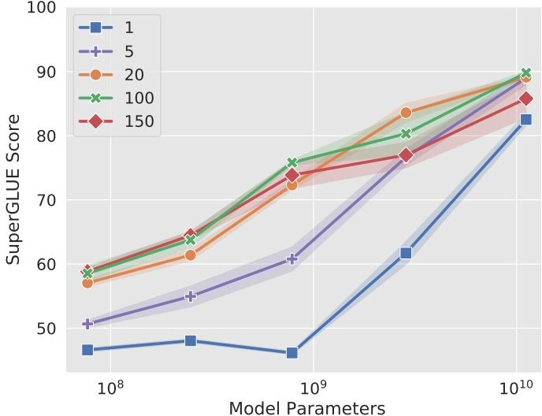
Prompt Tuning: Effect of Prompt Length
The shorter the prompt, the fewer new parameters must be tuned
Increasing prompt length is critical to achieving good performance
The largest model still gives strong results with a single-token prompt
Increasing beyond 20 tokens only yields marginal gains
[The Power of Scale for Parameter-Efficient Prompt Tuning. Lester et al. 2021]

Slide 19
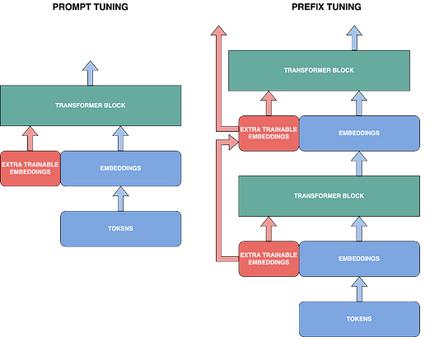
Prefix-tuning vs Prompt-tuning
Prompt-tuning, extra trainable embeddings are simply prepended to the model’s input.
Prefix-tuning, similar to prompt tuning but applied at every attention layer of the model.
Figure source: https://blog.dataiku.com/parameter-efficient-llm-fine-tuning

Slide 20
Reparametrization based methods
Reparametrize the weights of the network using a low-rank transformation. This decreases the trainable parameter count while still allowing the method to work with high-dimensional matrices
71

Slide 21
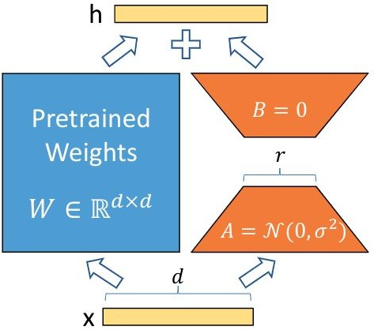
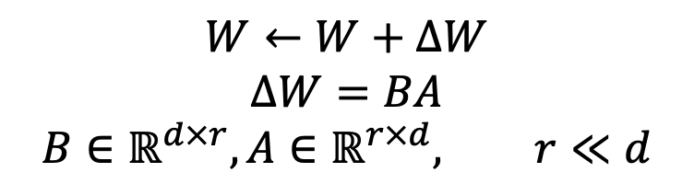
LoRA: Low-Rank Adaptation
Hypothesis: the intrinsic rank of the weight matrices in a large language model is low.
Parameter update for a weight matrix is decomposed into a product of two low-rank matrices.
A is initialized with random Gaussian Initialization, B is initialized to zero.
$$W←W+ΔW$$
$$ΔW=BA$$
$$B∈ℝ^{d×r},A∈ℝ^{r×d}, r≪d$$
[“LoRA: Low-Rank Adaptation of Large Language Models” Hu et al., 2021.]

Slide 22
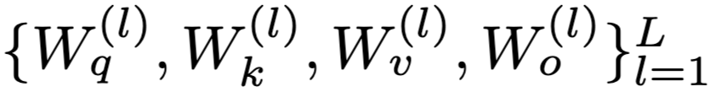
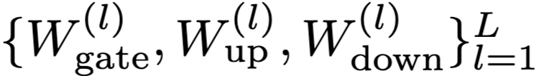
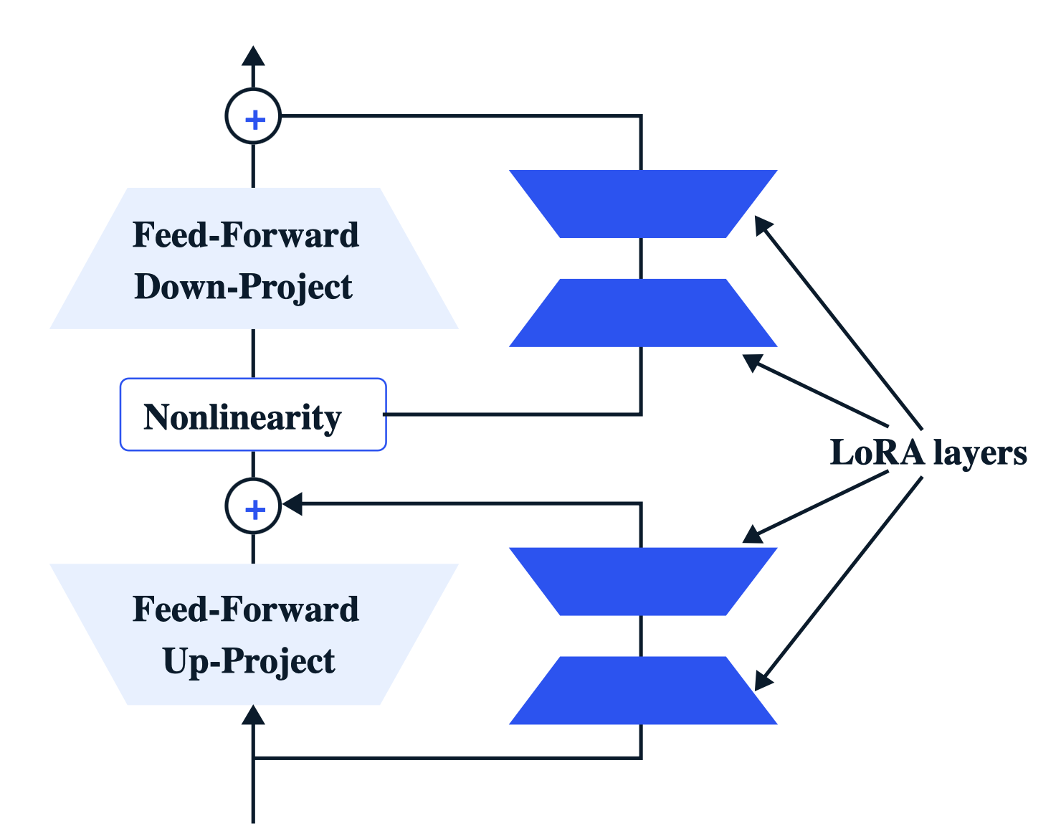
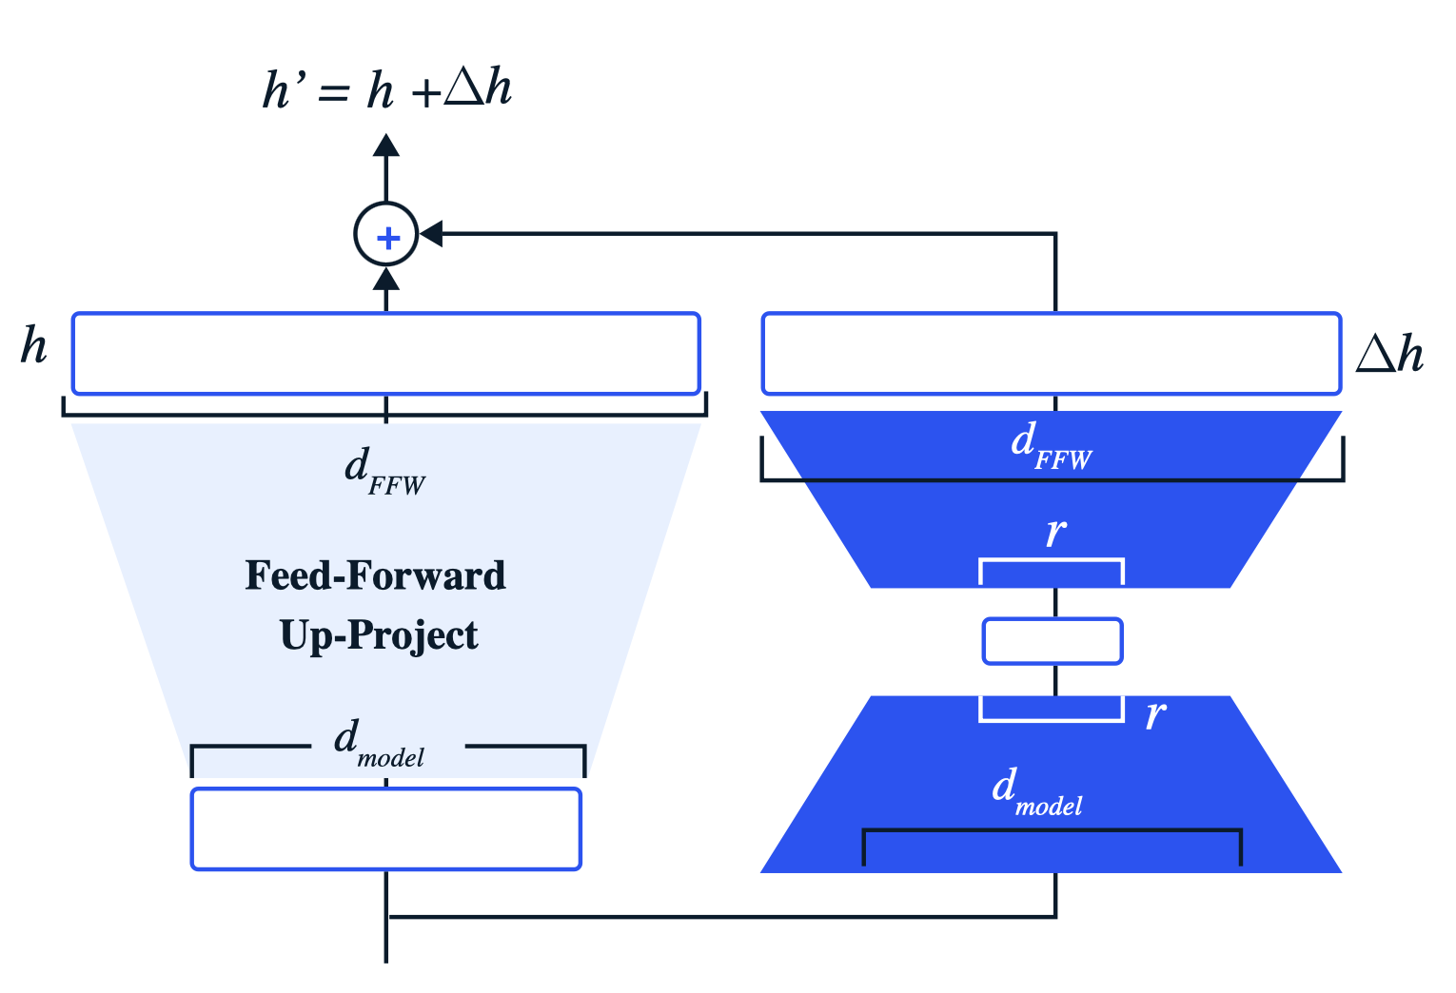

LoRA: Where you place them?
LoRA used to be applied to $W_{q}$ and $W_{v}$ matrices in SA.
But since then, it’s been common to target all matrices in SA and FFN of all layers.
[Figure credit: Samet Oymak]

Slide 23
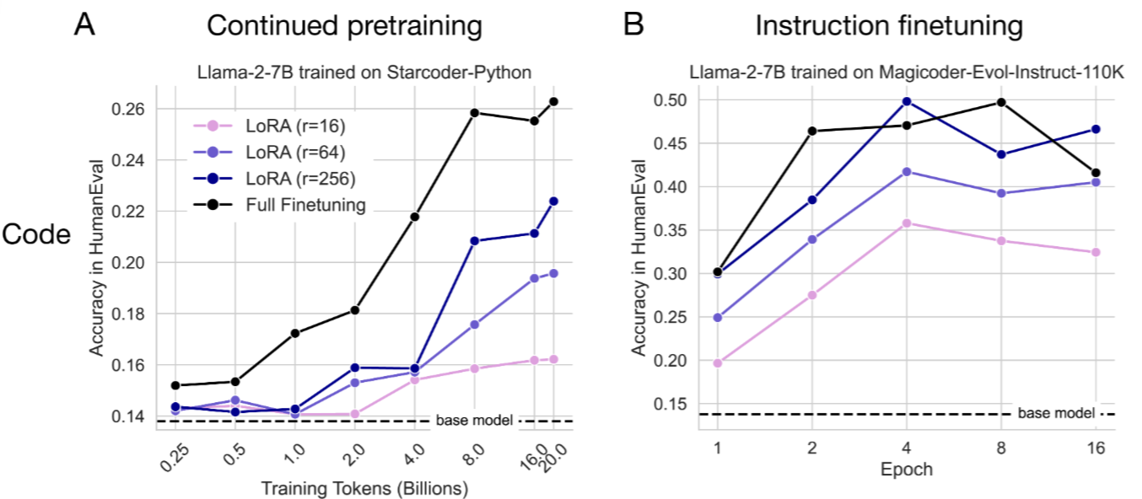
LoRA, empirically
LoRA [at low ranks] underperforms full finetuning.
[LoRA Learns Less and Forgets Less, 2024]

Slide 24
LoRA: impact on memory footprint
TODO: explain how LoRA helps with memory footprint.
My current impression is that we save memory by not computing extra gradients.
But we still need to store the whole model in GPU memory.

Slide 25
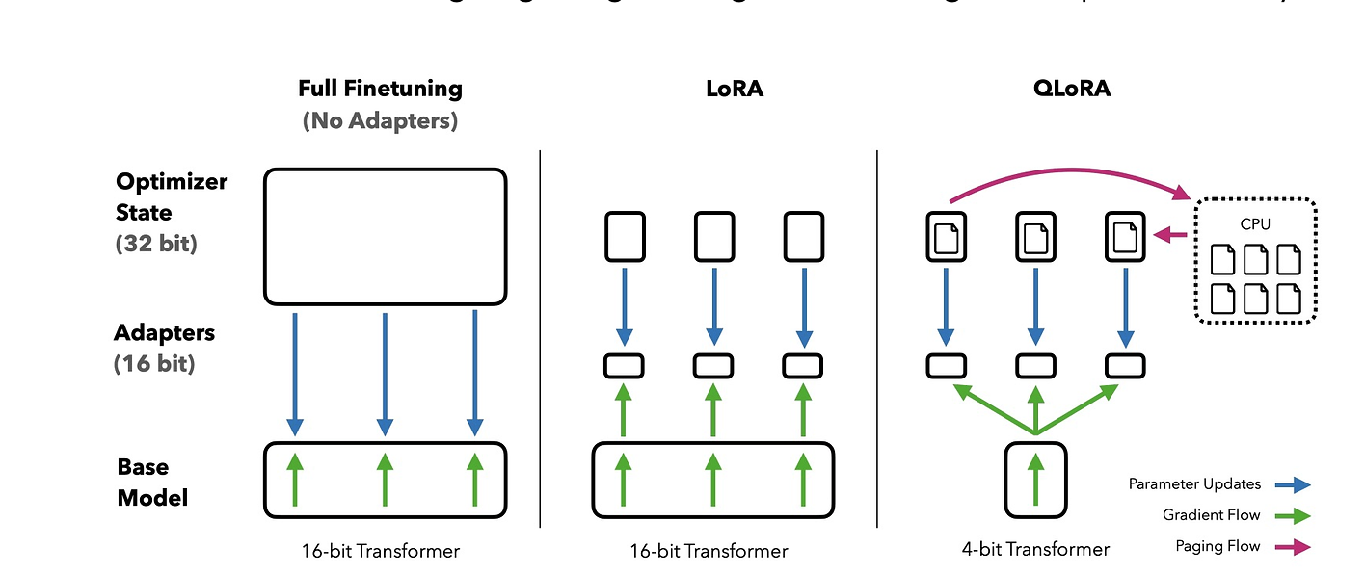
Recent extensions: QLoRA
QLoRA (Quantized Low-Rank Adaptation)
QLoRA is an extension of the PEFT approach for adapting large pre-trained language models like BERT. QLORA backpropagates gradients through a frozen, 4-bit quantized pretrained language model into LoRA parameters.

Slide 26
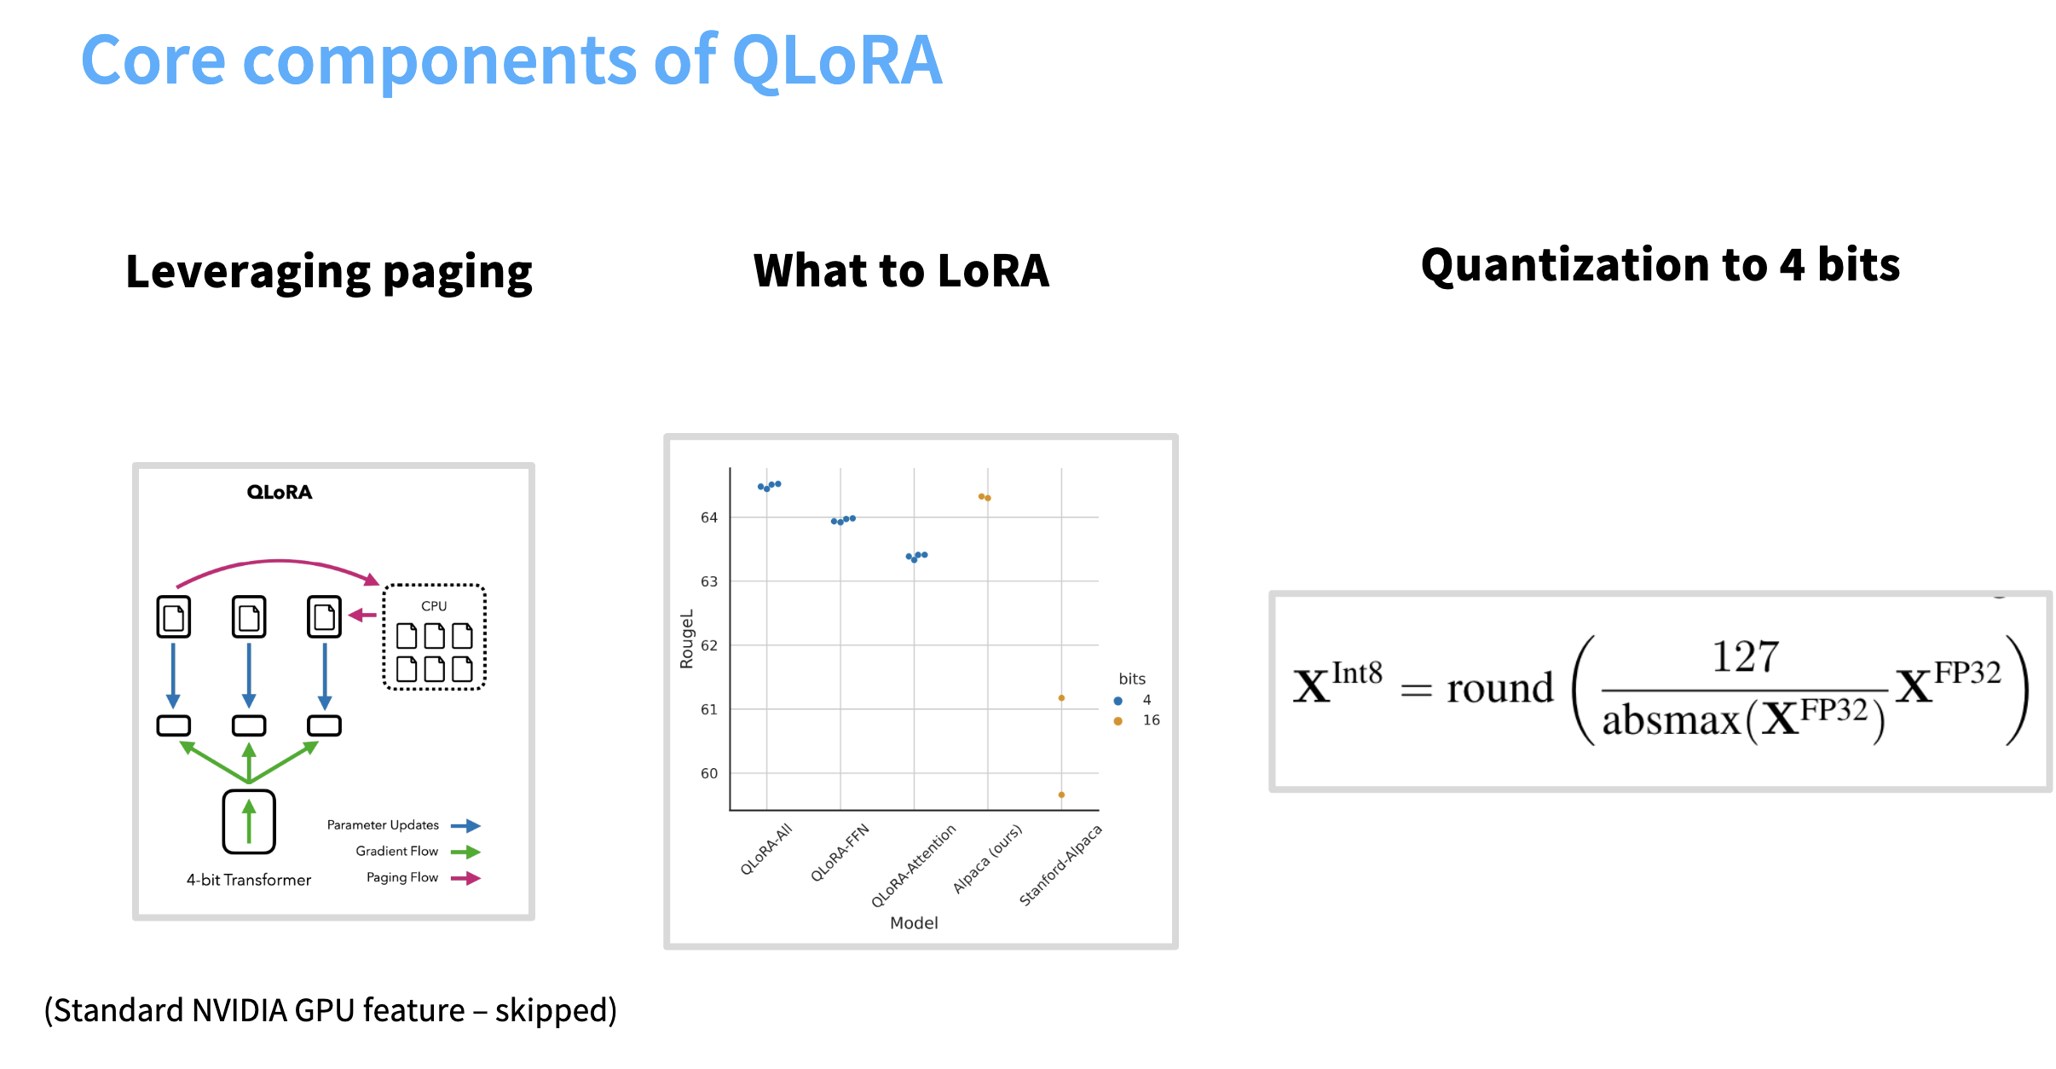
Incorporate: QLoRA

Slide 27
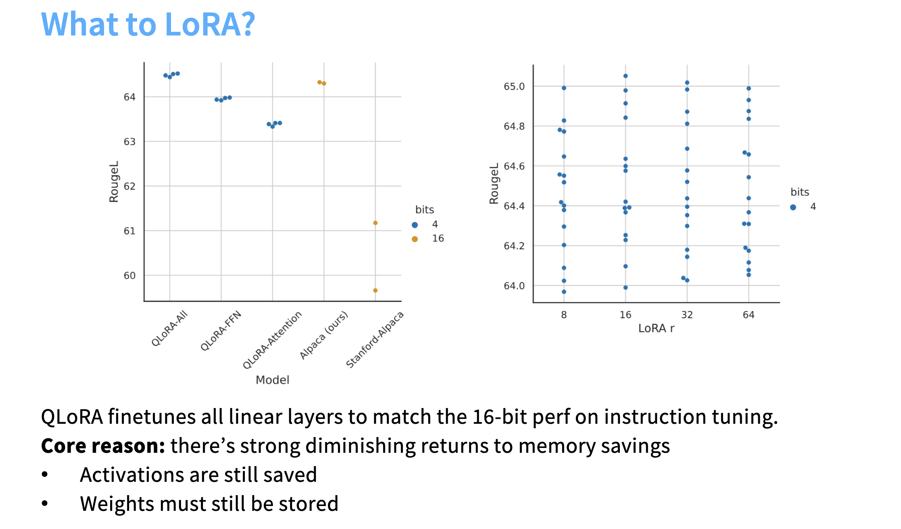
QLoRA

Slide 29
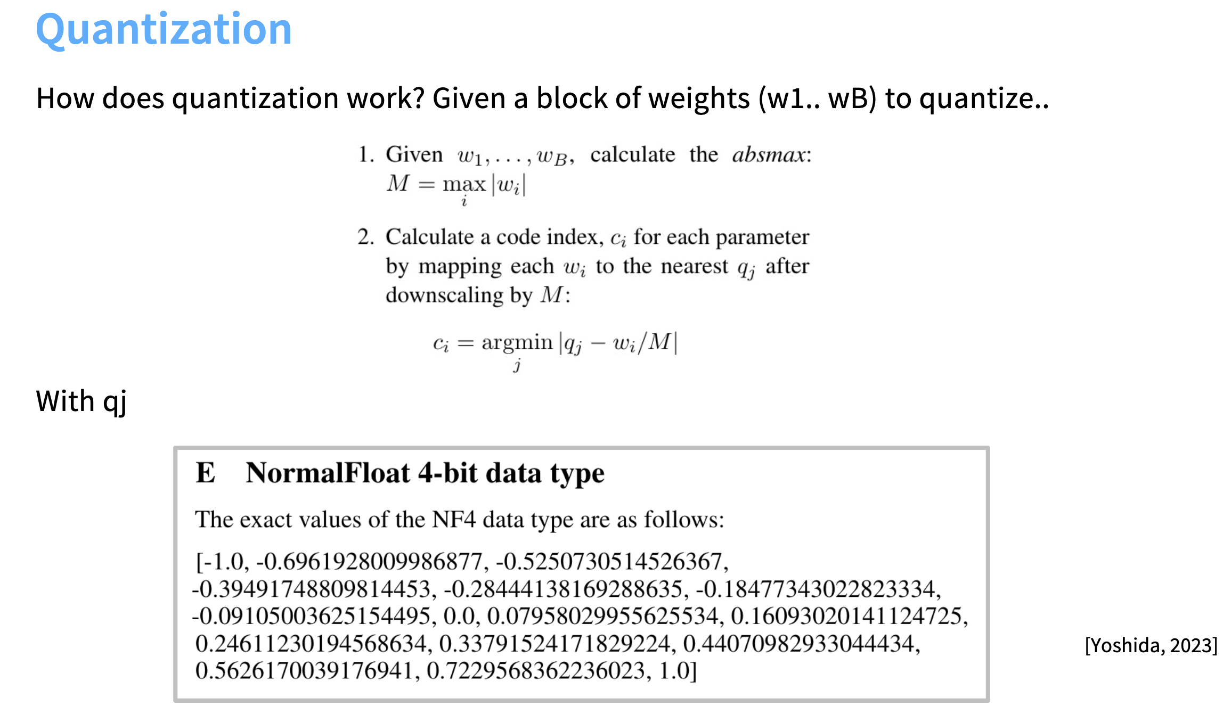
QLoRA

Slide 30
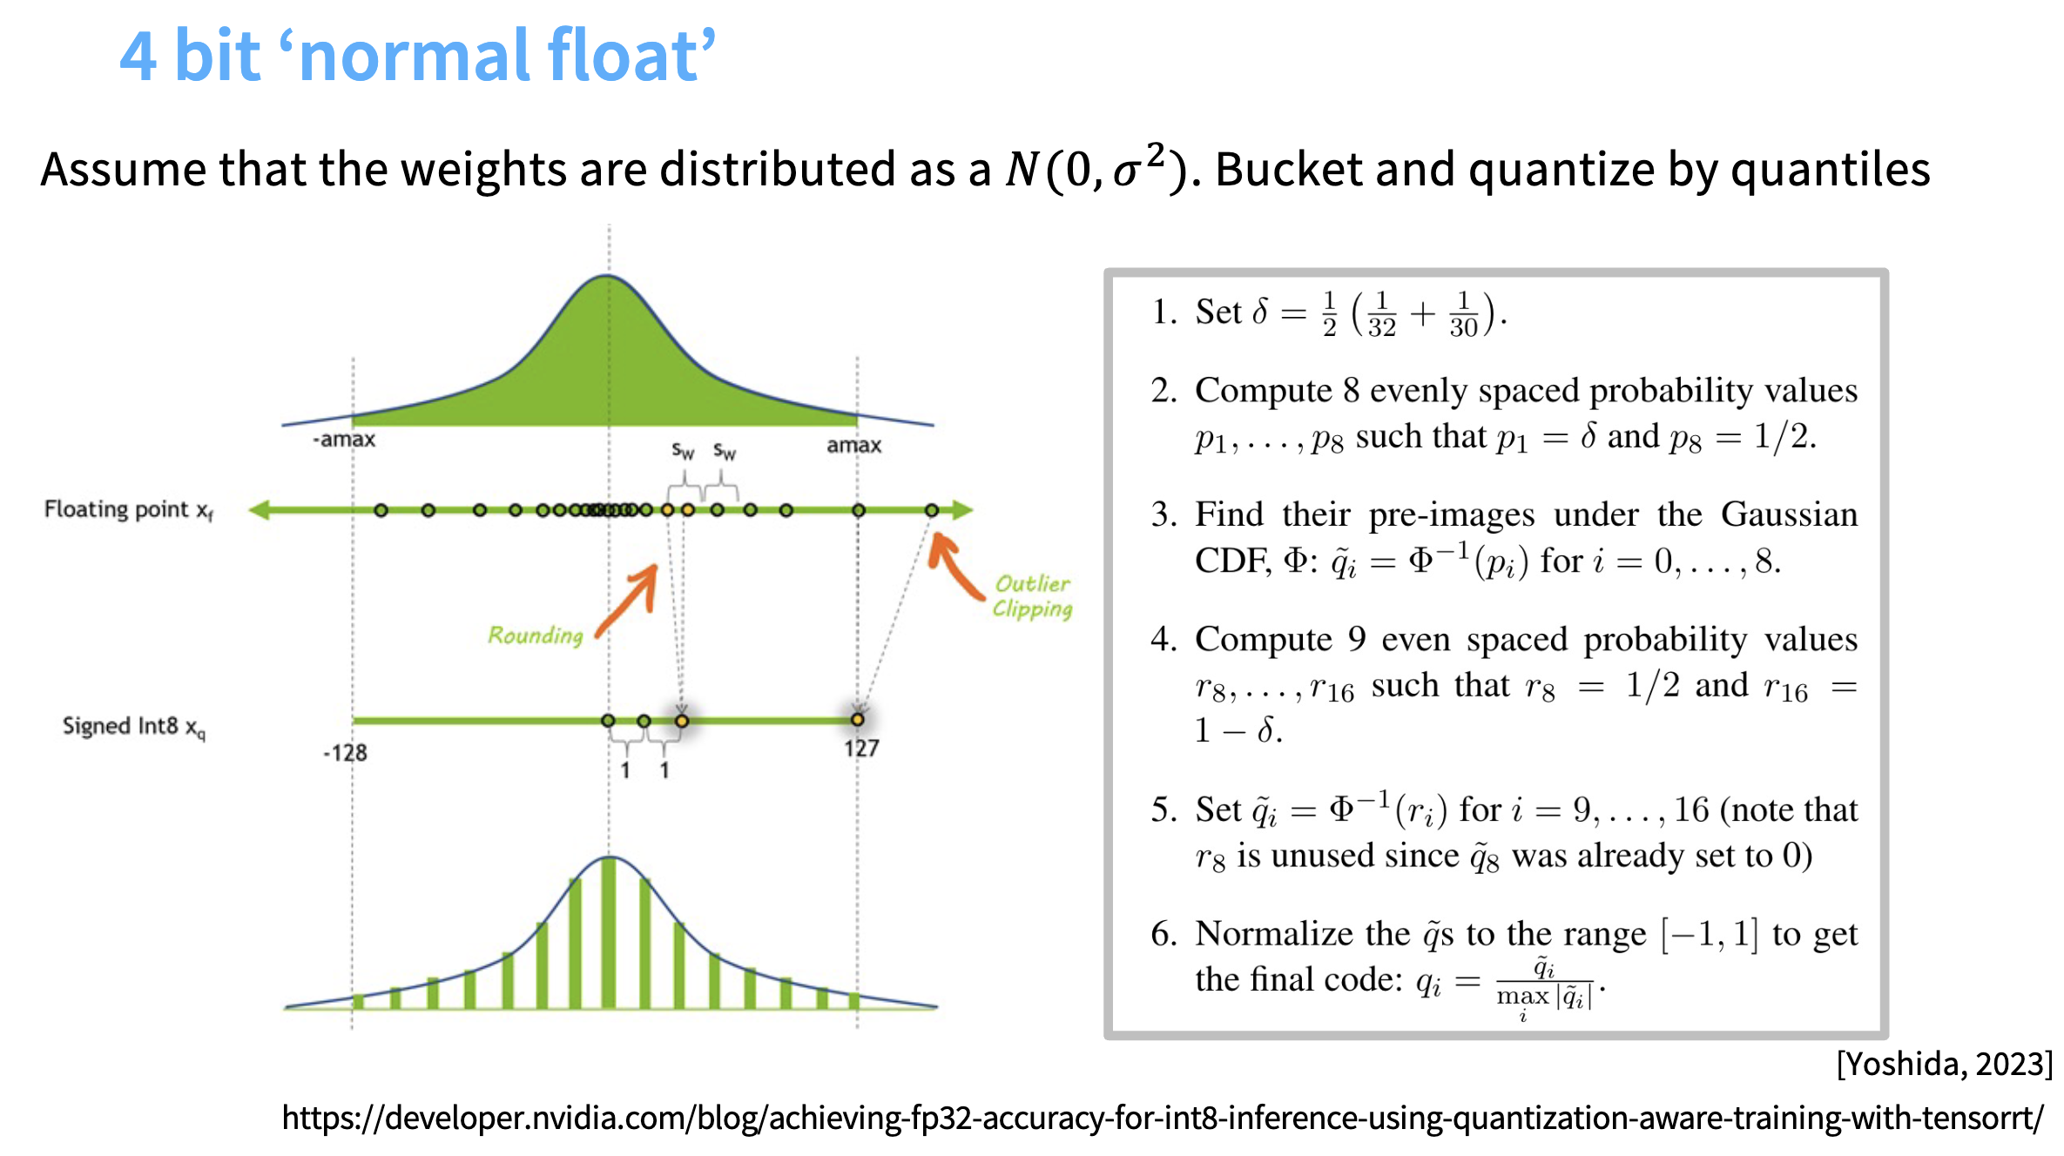
QLoRA

Slide 31
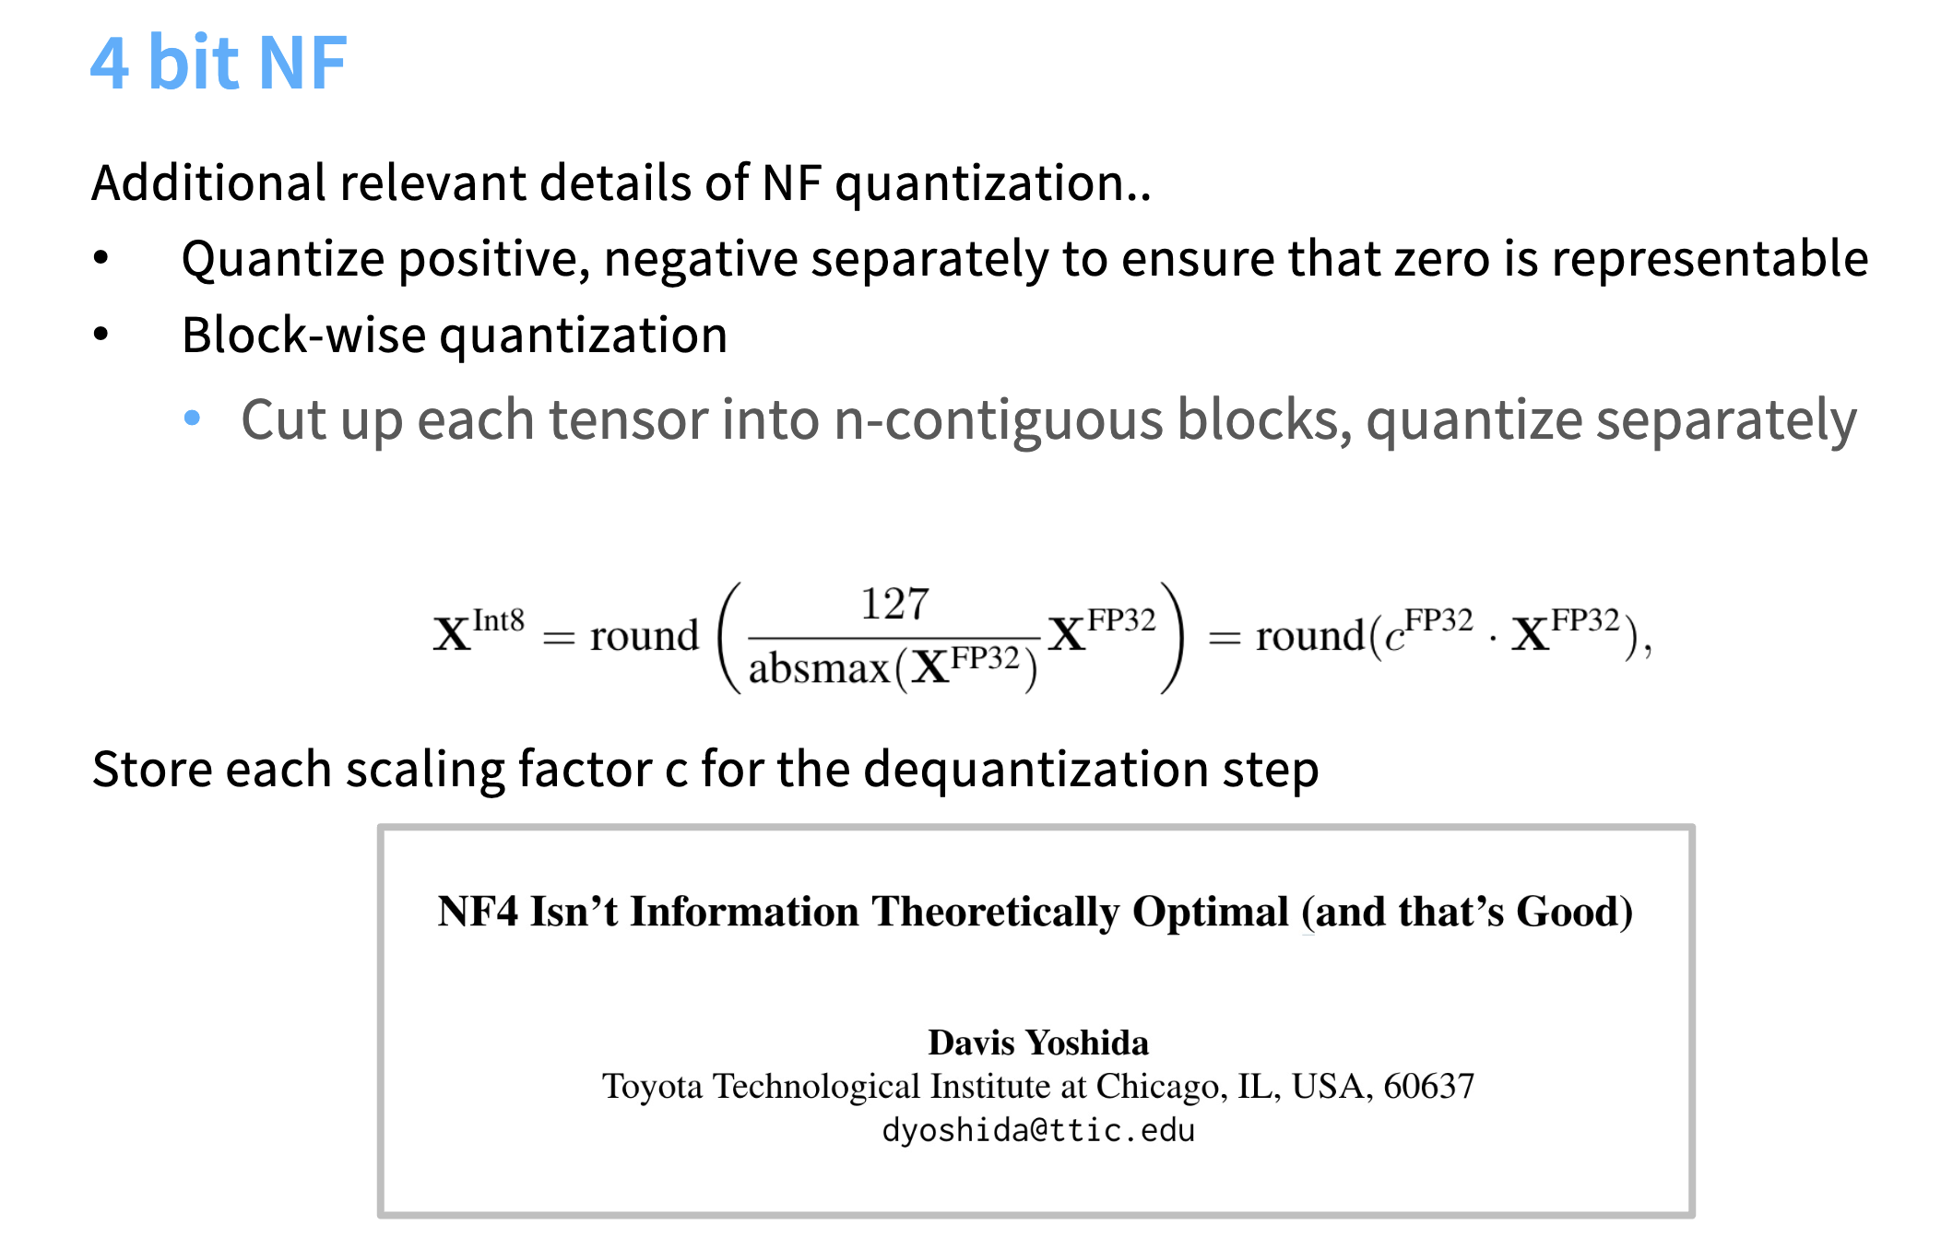
QLoRA

Slide 32
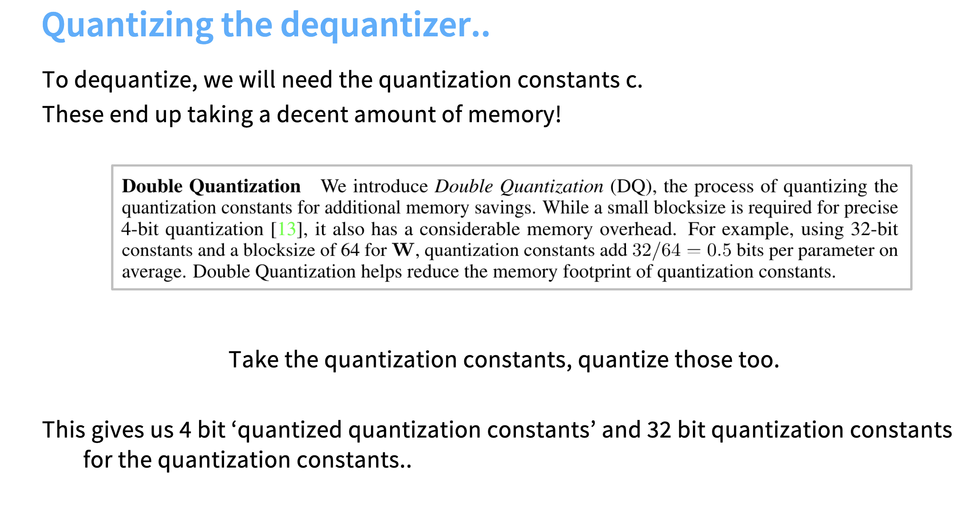
QLoRA

Slide 33
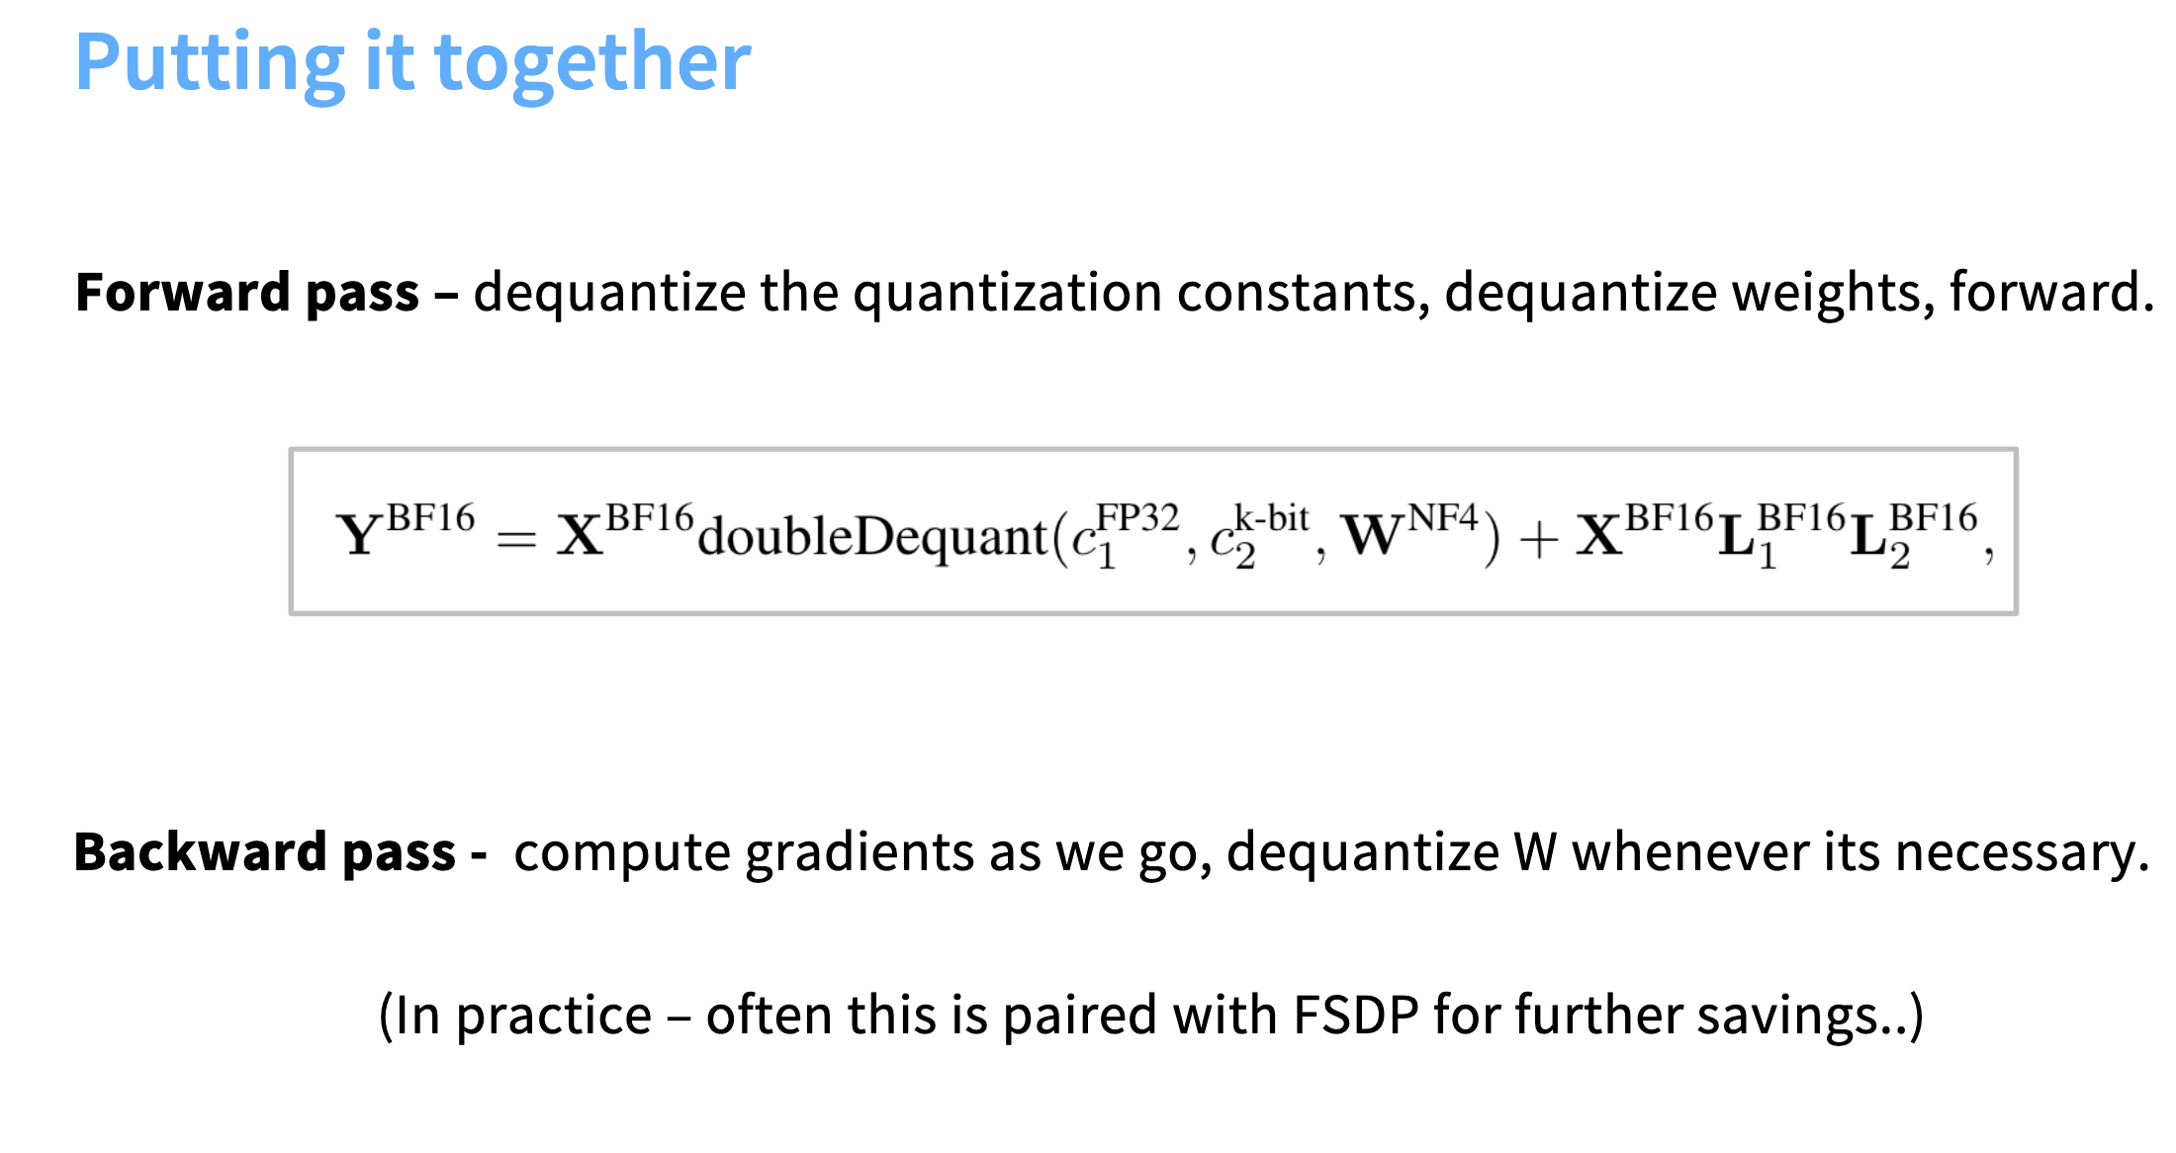
QLoRA

Slide 34
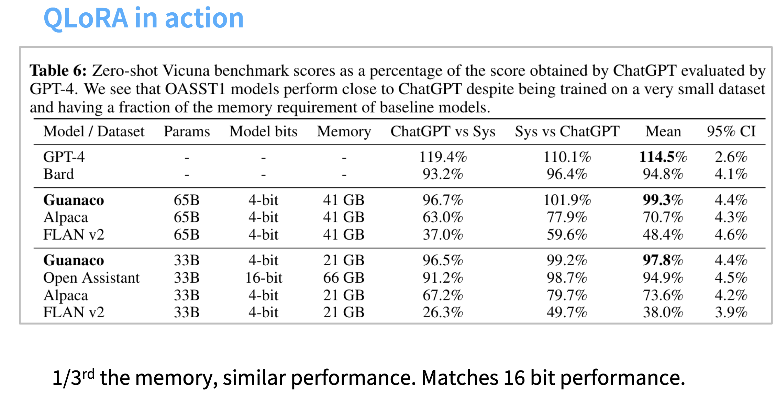
QLoRA

Slide 35
Incorporate: QLoRA
https://docs.google.com/presentation/d/1jv-gSJjaYHjZQa8QC67j6RUFu30zQViJ8CRjQw55EBQ/edit?usp=sharing

Slide 36
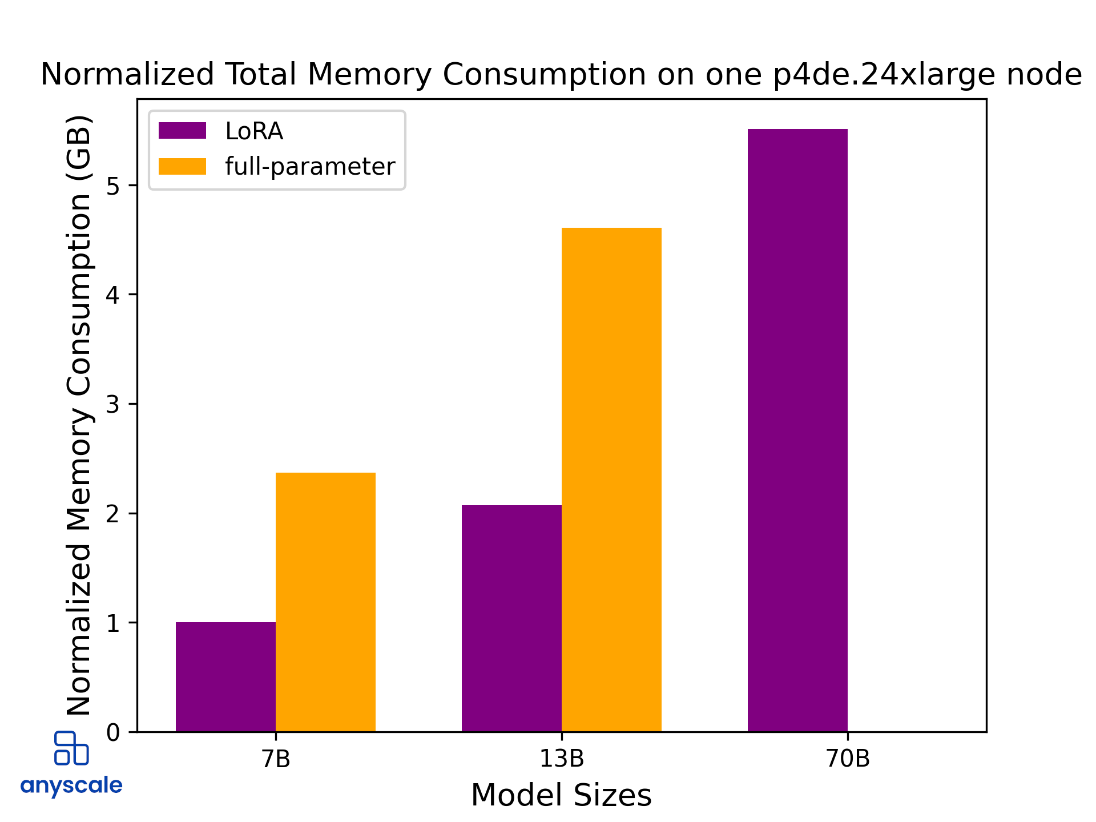
LoRA memory footprint
LoRA reduces memory requirements during fine-tuning (up to x3 for LoRA).
Why?
https://www.anyscale.com/blog/fine-tuning-llms-lora-or-full-parameter-an-in-depth-analysis-with-llama-2

Slide 37
LoRA: Compute Cost
Does LoRA lead to computational speedup?
No, in the sense that you still need to run the same operations during forward and backward.
Yes, in the sense that you can fit larger batches in your memory.

Slide 38
Recap: LoRA
LoRA: Low-rank adaptation to Transformer weight matrices.
Memory footprint: LoRa reduces memory requirements during fine-tuning (up to x3 for LoRA).
Impact on floating-point operations: LoRA’s impact on on FLOPs, during training or inference, is minimal. You still need same FLOPs for forward/backward passes even if you update few parameters. You just apply less number of gradient updates.
The main speedup is coming from the fast that you can pack more things in a batch.

Slide 39
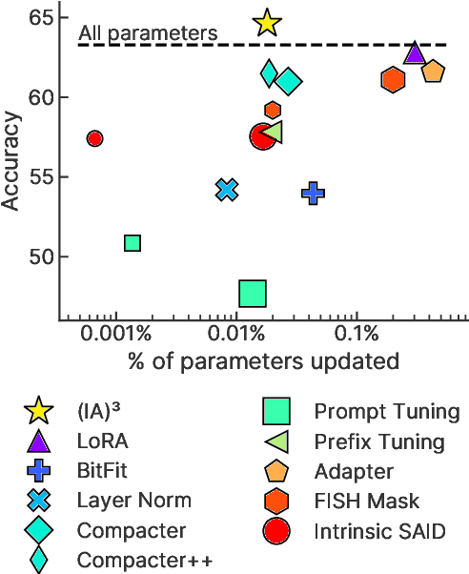
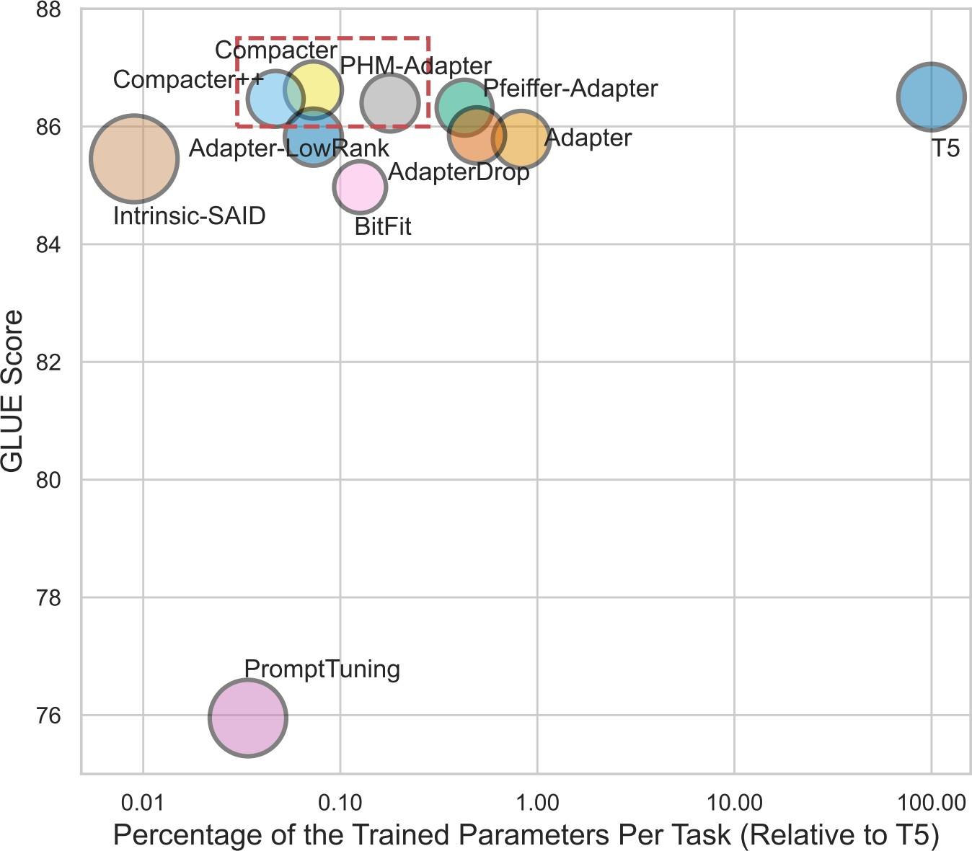
Performance/compactness comparison

Slide 40
Summary: Adaptation via Fine-Tuning
Parameter efficient optimization — optimize fewer parameters than the whole model.
Space efficiency — fewer parameters to store
Computation efficiency? A bit unclear
Their interpretability is not quite clear.
See: https://huggingface.co/docs/trl/index

Slide 41
Selective methods
Bonus
Selective methods fine-tune a subset of the existing parameters of the model.
It could be a layer depth-based selection, layer type-based selection, or even individual parameter selection.
Ben Zaken et al., 2021. “BitFit: Simple Parameter-eﬃcient Fine-tuning for Transformer-based Masked Language-models”

Slide 42
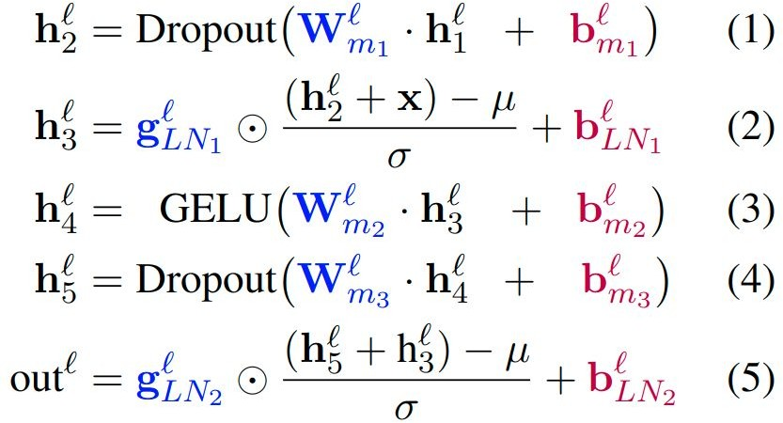
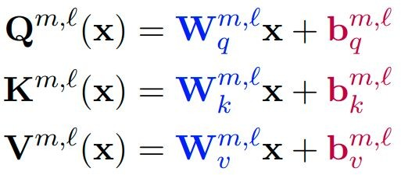
BitFit
120
Bonus
BitFit adds bias terms in self-attention and MLP layers and tunes those.
BitFit only updates about 0.05% of the model parameters.
Ben Zaken et al., 2021. “BitFit: Simple Parameter-eﬃcient Fine-tuning for Transformer-based Masked Language-models”

Slide 43
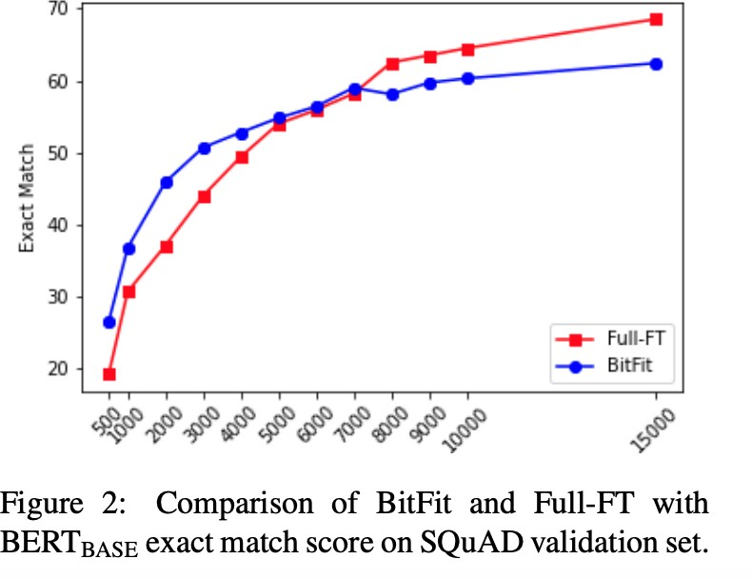
BitFit
Bonus
Ben Zaken et al., 2021. “BitFit: Simple Parameter-eﬃcient Fine-tuning for Transformer-based Masked Language-models”

Slide 44
Parameter-efficient Fine-tuning: Adding Models
Bonus
Augmenting the existing pre-trained model with extra parameters or layers and training only the new parameters
Two commonly used methods:
Soft prompts
Adapters

Slide 45
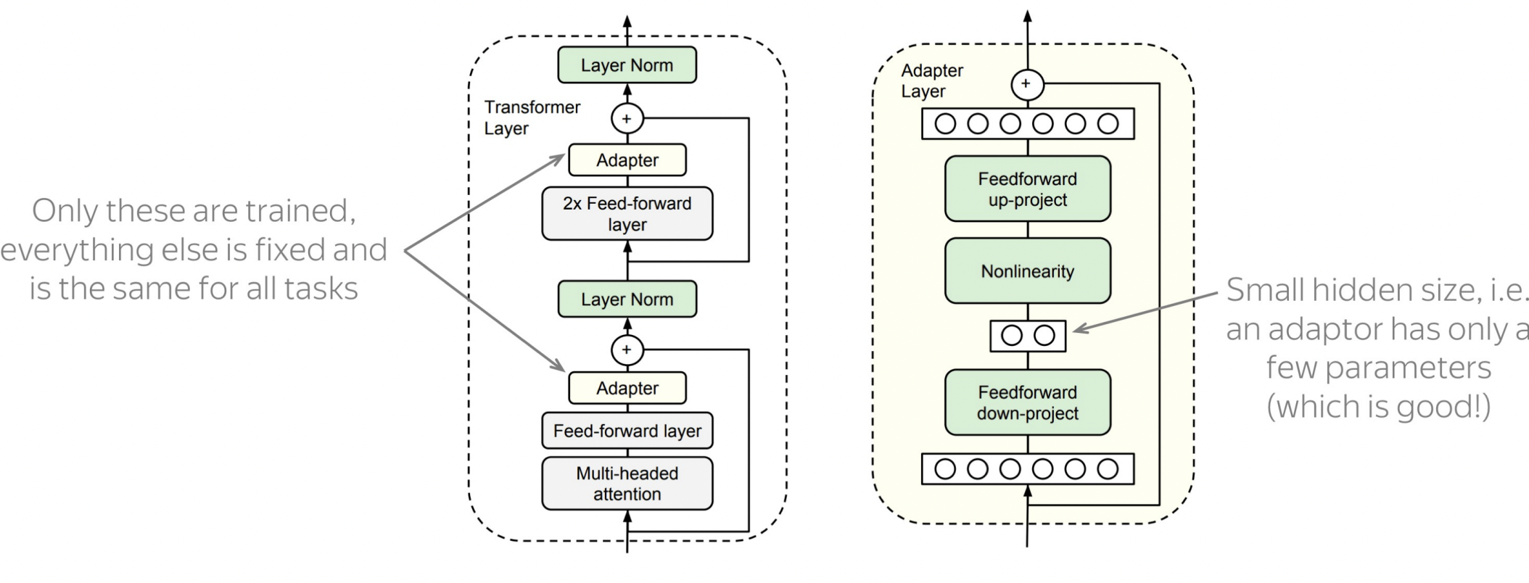
Adapters
Bonus
Idea: train small sub-networks and only tune those.
FF projects to a low dimensional space to reduce parameters.
No need to store a full model for each task, only the adapter params.
Right: The adapter consists of a bottleneck which contains few parameters relative to the attention and feedforward layers in the original model. The adapter also contains a skip connection.
Left: Add the adapter module twice to each Transformer layer: after the projection following multi-headed attention and after the two feed-forward layers.
[“Parameter-Eﬃcient Transfer Learning for NLP”, Houlsby et al., 2019.]

Slide 46
Question
Bonus
Is parameter-efficient tuning more (1) computationally efficient; (2) memory-efficient than whole-model tuning?
It is not faster! You still need to do the entire forward and backward pass.
It is more memory efficient.
You only need to keep the optimizer state for parameters that you are fine-tuning and not all the parameters.

Slide 47
Bonus
Are continuous prompts as interpretable as Discrete (Language) prompts?

Slide 48

[Continuous] Prompt Waywardness
Bonus
Prompt waywardness hypothesis, states that:
There are infinite-many continuous prompts that can solve a given task.
LM
Sentence: That was a great fantasy movie.
positive
["Prompt Waywardness: The Curious Case of Discretized Interpretation of Continuous Prompts" Khashabi et al., 2022.]

Slide 49
[Continuous] Prompt Waywardness
Bonus
Prompt waywardness hypothesis, states that:
There are infinite-many continuous prompts that can solve a given task.
There exist continuous prompts that ”project” to the description of irrelevant or contradictory tasks.
Project := nearest-neighbor mapping of continuous prompt onto the word embeddings
definition of another task:
Write down the conclusion you can reach by combining the given Fact 1 and Fact 2.
random sentence from web:
int clamp(int val, int min_val) { return std::max(min_val, val); }
LM
Sentence: That was a great fantasy movie.
positive
["Prompt Waywardness: The Curious Case of Discretized Interpretation of Continuous Prompts" Khashabi et al., 2022.]

Slide 50
Bonus
discrete (text) prompts: easy to interpret, but not easy to optimize
What is the sentiment of the following review? (positive or negative)
LM
Sentence: That was a great fantasy movie.
positive
continuous prompts:
unclear how to interpret, but easy to optimize
0.9 | 0.1 | -2.1 | 0.0
LM
Sentence: That was a great fantasy movie.
positive
["Prompt Waywardness: The Curious Case of Discretized Interpretation of Continuous Prompts" Khashabi et al., 2022.]
Notes:
... continuous prompts
Typically defined as a vector of real numbers prepended to the embedding of an input text to make the model generate a desired outcome.
For example, a continuous prompts that effectively solves the sentiment classification task.
Turns out that continuous prompts are complementary to their discrete counterparts:
We have algorithms for effectively optimizing them.
However, meaningful interpretation of continuous prompts as natural language is an open question problem.
(click) --- maybe this particular continuous prompt has something to do with sentiment analysis?? Unclear.
Motivated by this, we are interested in the research question of …
Motivated by the discrepancies between discrete and continuous prompts, we study focus continuous prompts and their interpretability.

Slide 51
Prompting and In-Context Learning

Slide 52
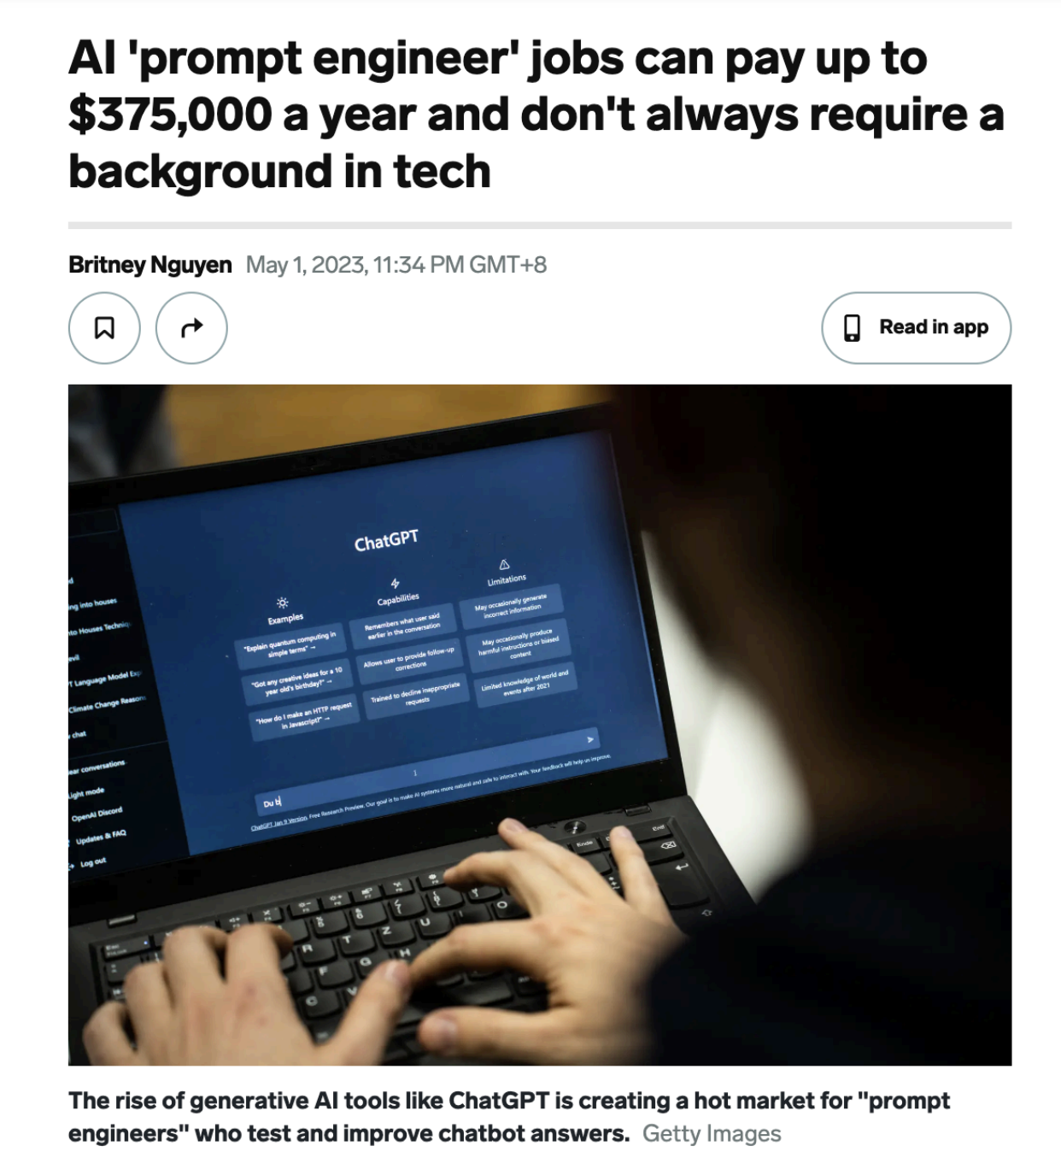
Prompt Engineering
Reformulating tasks to a language that is easier to for the models.
Show demonstrations
Decompose your problem
Ask for rationales (a la CoT)
Check for consistency
…
Question for you: will ”prompt engineering” be relevant topic in the coming years?
Notes:
Prompt engineering

Slide 53
Limitations of Pre-training, then Fine-tuning
Often you need a large labeled data
Though more pre-training can reduce the need for labeled data

Slide 54
Limitations of Pre-training, then Fine-tuning
Often you need a large labeled data
Though more pre-training can reduce the need for labeled data
End up with many copies (or sub-copies) of the same [sub]model

Slide 55
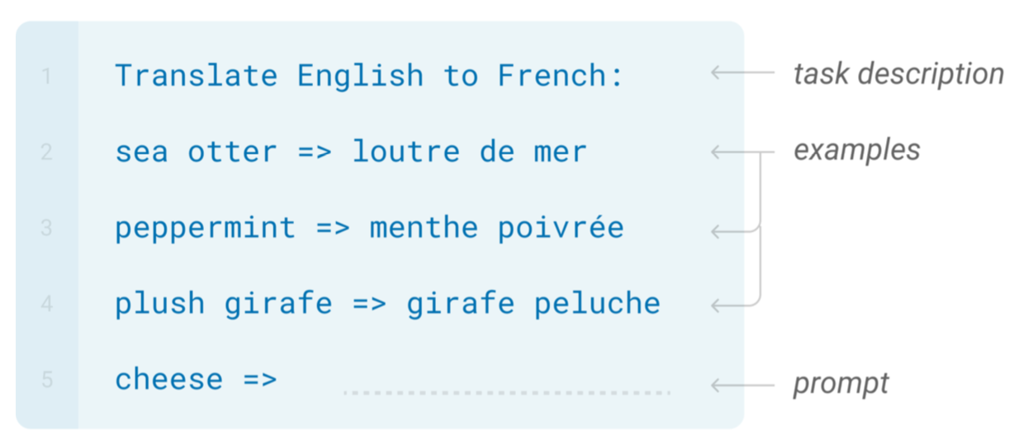
In-Context Learning

Slide 56
In-Context Learning
Learns to do a downstream task by conditioning on input-output examples!
No weight update — our model is not explicitly pre-trained to learn from examples
The underlying models are quite general
Today’s focus:
How to use effectively in practice?
Fundamentally, why does it work?

Slide 57
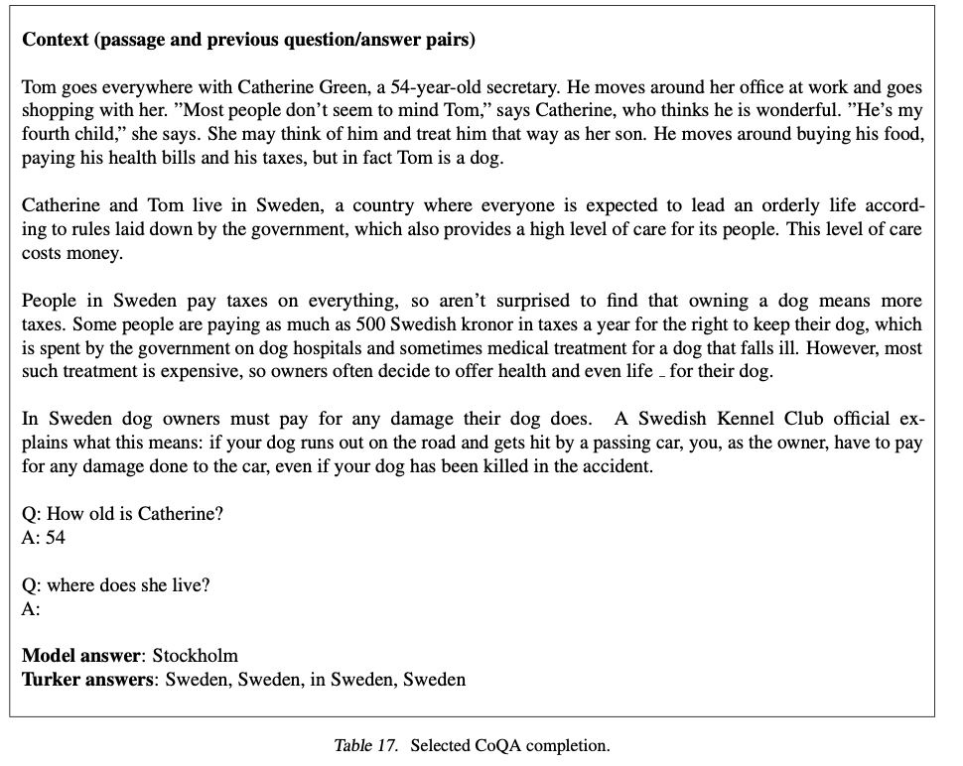
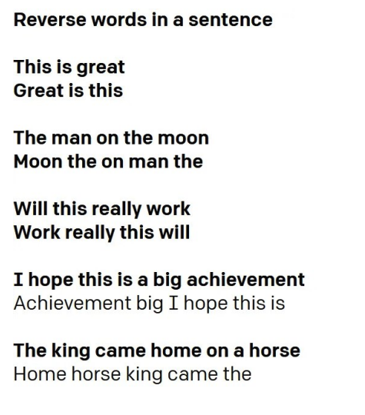
In-Context Learning
https://gpt3experiments.substack.com/p/is-gpt-3-really-doing-few-shot-learning

Slide 58
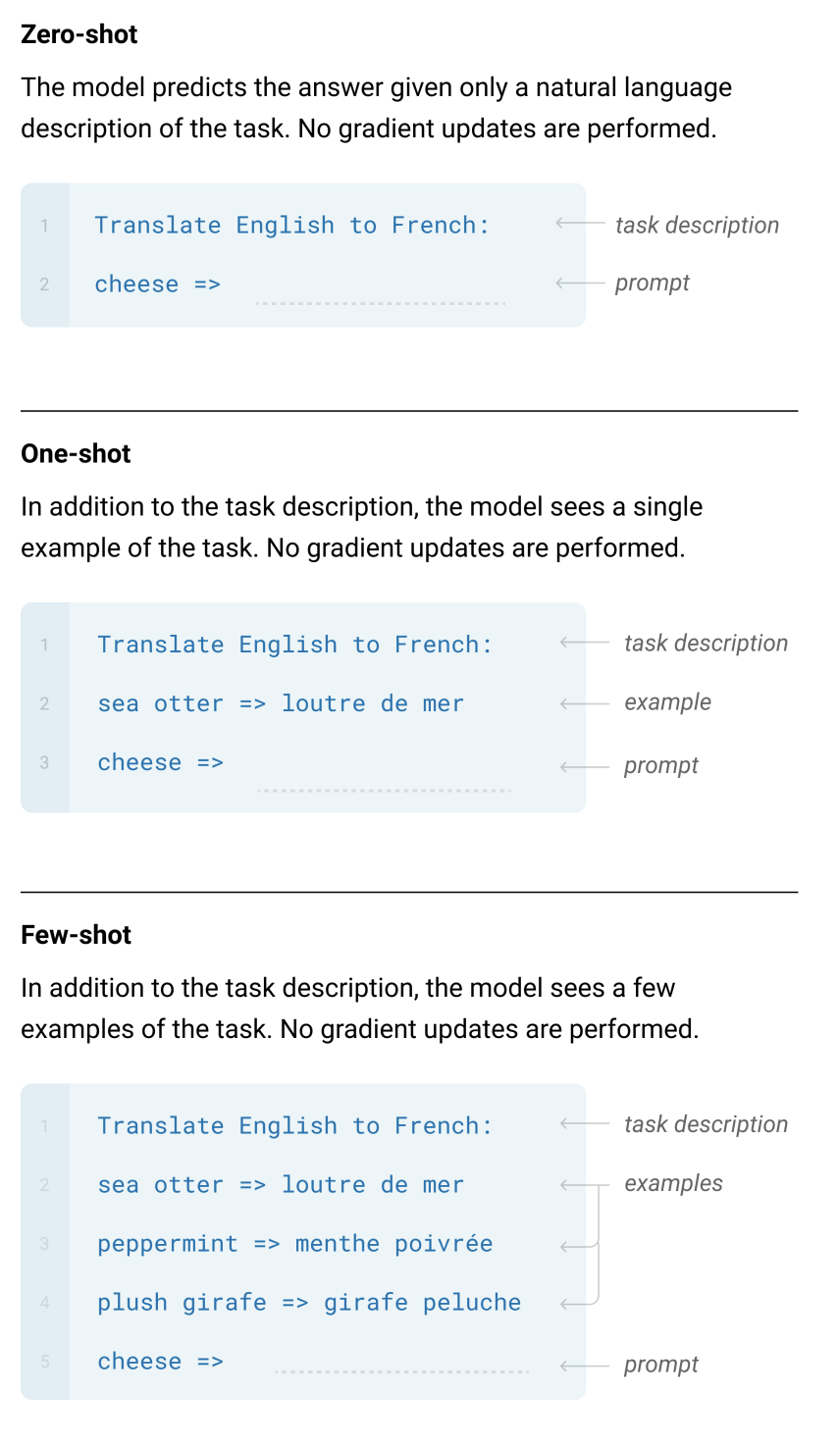
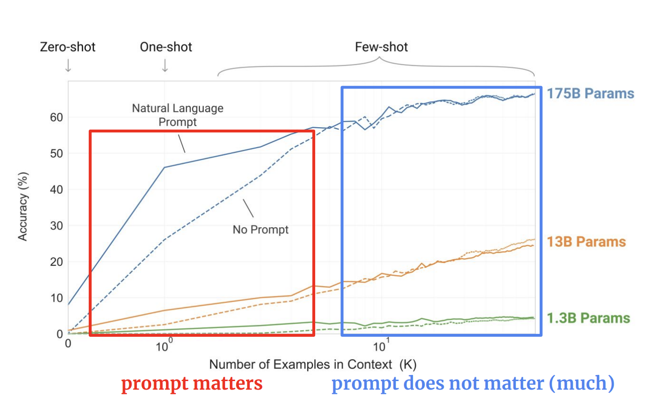
GPT-3: Language Models are Few-Shot Learners

Slide 59
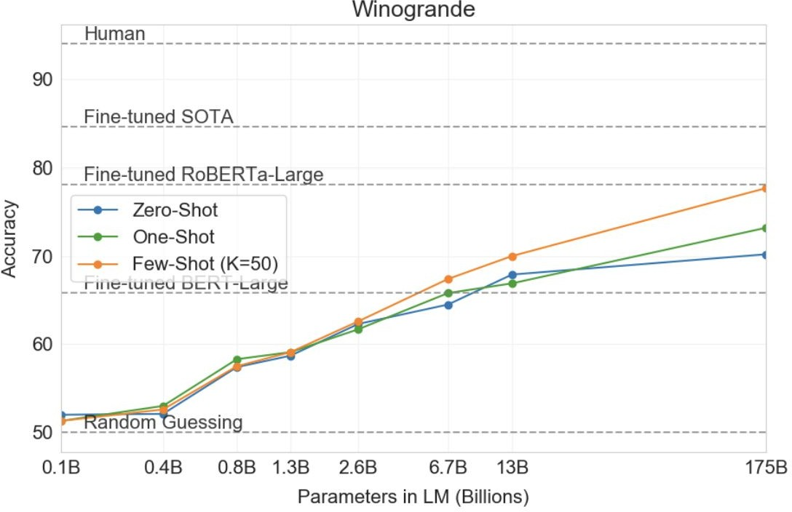
In-context learning results
Brown et al. 2020. “Language Models are Few-Shot Learners”

Slide 60
In-Context Prompting: Implementation
Movie review dataset
Input: An effortlessly accomplished and richly resonant work.
Label: positive
Input: A mostly tired retread of several other mob tales.
Label: negative
An effortlessly accomplished and richly resonant work. It was great! A mostly tired retread of several other mob tales. It was terrible!
A three-hour cinema master class. It was
Language Model
p1 = P(It was great! | 1st train input+output \n 2nd train input+output \n A three-hour cinema master class.)
p2 = P(It was terrible! | 1st train input+output \n 2nd train input+output \n A three-hour cinema master class.)
p1 > p2 →
p1 < p2 →
“positive” “negative”
[ACL 2022 Tutorial Beltagy, Cohan, Logan IV, Min and Singh]

Slide 61
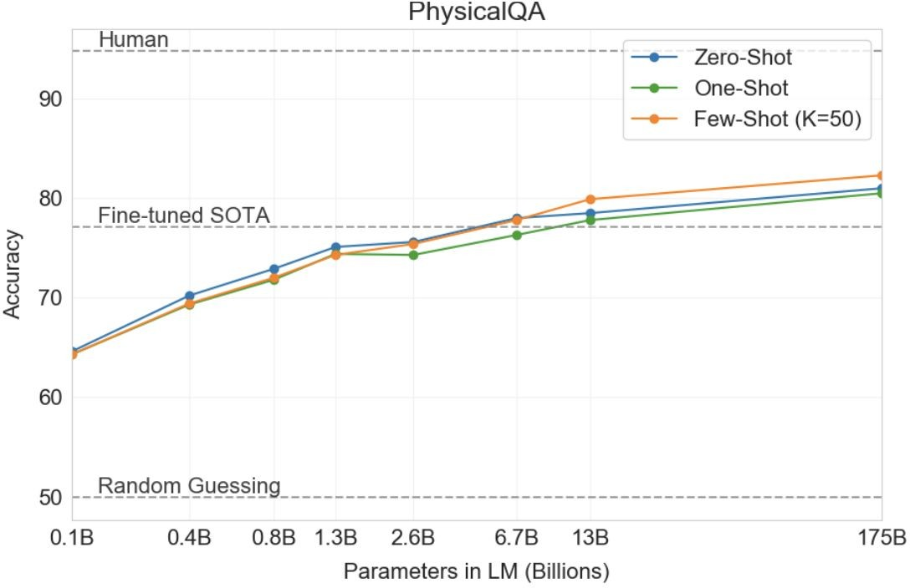
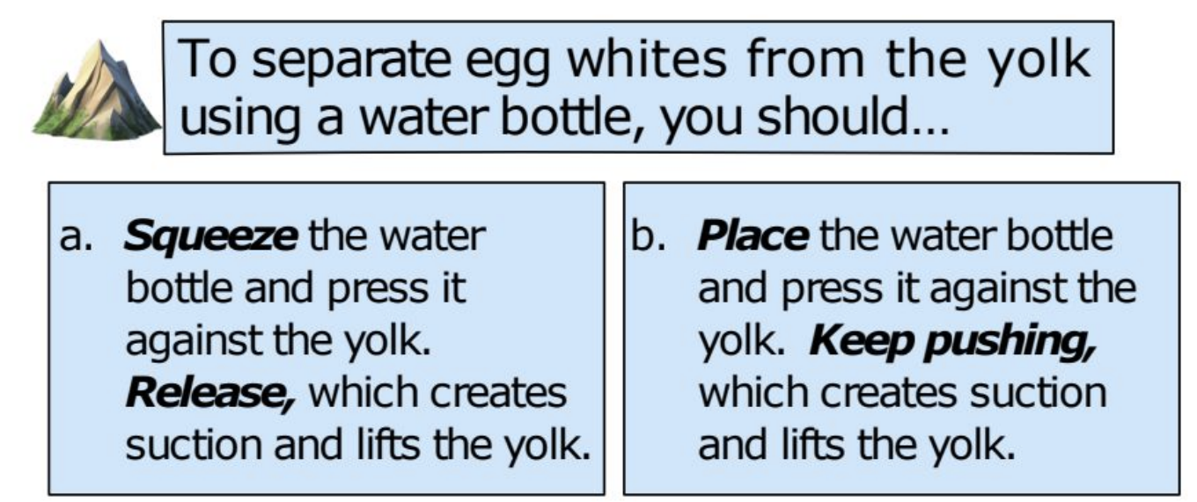
In-Context learning Results
Brown et al. 2020. “Language Models are Few-Shot Learners”

Slide 62
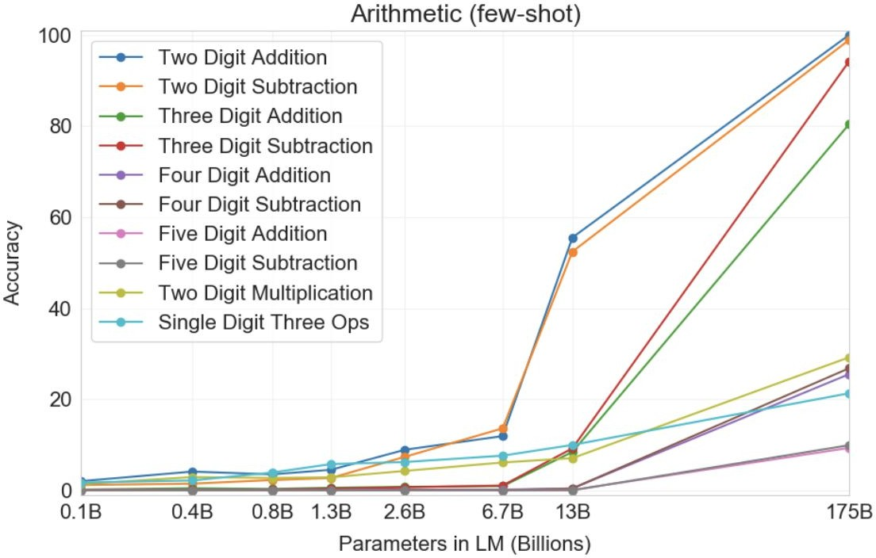
In-Context learning Results
Example:
Q: What is 48 plus 76?
A: 124
Observations:
Scale is important
Number of digits correlate with their difficulty.
Multiplication is harder than summation!
Brown et al. 2020. “Language Models are Few-Shot Learners”

Slide 63
Why Do We Care About In-Context Learning?
Practically Useful
Intellectually Intriguing
[ACL 2022 Tutorial Beltagy, Cohan, Logan IV, Min and Singh]

Slide 64
In-Context Learning: Practically Useful
May require domain expertise
Medical, legal, ﬁnancial
You don’t want to get more data
Emergent, time-sensitive scenarios
Something new happened—need to react quickly!
Labeling data is costly
Finetuning can tricky
Training is sensitive to hyperparams
Not enough validation data
We don’t quite understand how finetuning works
Expensive to train, time and memory
[ACL 2022 Tutorial Beltagy, Cohan, Logan IV, Min and Singh; quote credit: Colin Raffel]

Slide 65
In-Context Learning: Intellectually Intriguing
Potential test for “Intelligent Behavior”
Insights into Language Modeling
Generalization from few examples
Fundamental piece of intelligence
Often used in psychology
Quickly adjust to environment
What does an LLM “know”?
What are the biases/limitations of LLMs?
…
[ACL 2022 Tutorial Beltagy, Cohan, Logan IV, Min and Singh]

Slide 66
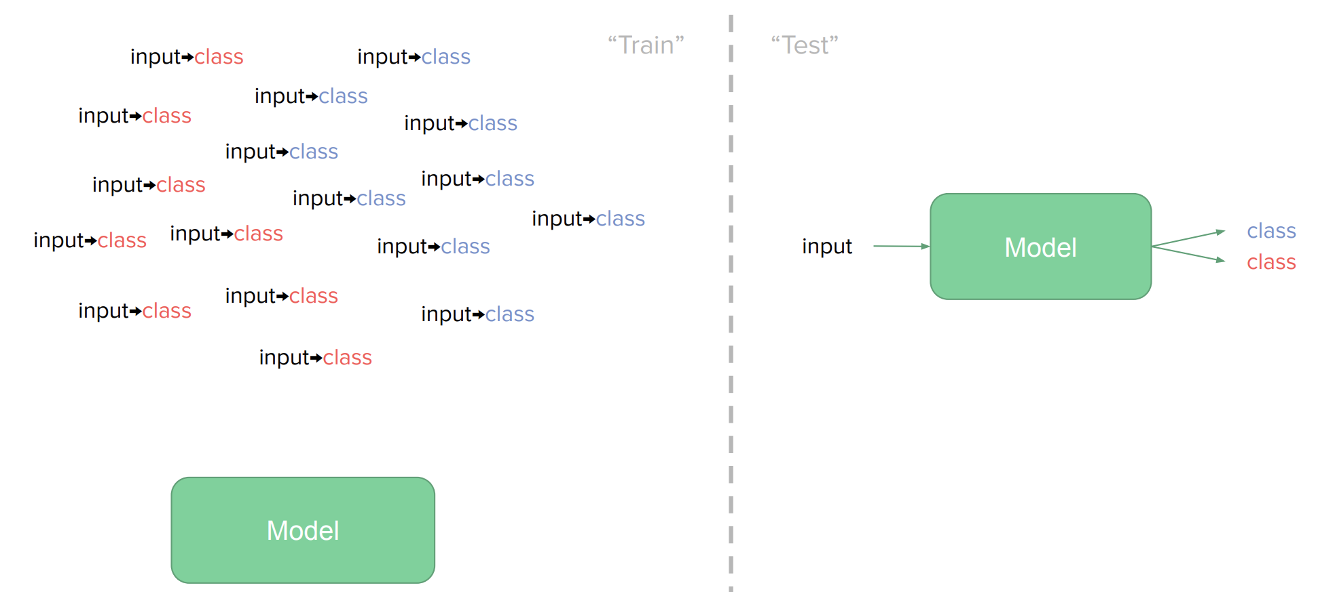
The Broader Context: Supervised Learning
[ACL 2022 Tutorial Beltagy, Cohan, Logan IV, Min and Singh]

Slide 67
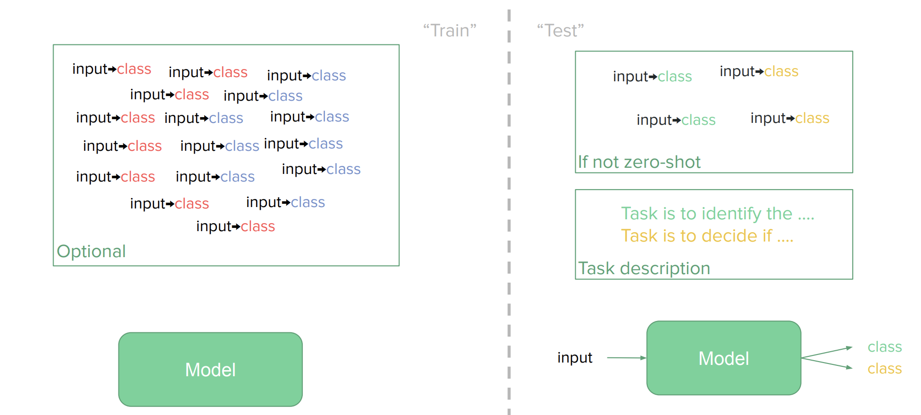
The Broader Context: [Modern] Few-shot Learning
[ACL 2022 Tutorial Beltagy, Cohan, Logan IV, Min and Singh]

Slide 68


ICL as a General-Purpose Few-Show Learning Mechanism
Any arbitrary task
Language Model
A few-shot learner
[ACL 2022 Tutorial Beltagy, Cohan, Logan IV, Min and Singh]

Slide 69
Summary
ICL is a surprising phenomenon that came out of large-scale pre-training LMs.
It allows test-time adaptation via examples.
Few examples are often enough—data efficient!
No parameter updates—no model replicas!
When does it work? What are its strength or weaknesses? 🤔

Slide 70
ICL’s Sensitivity

Slide 71
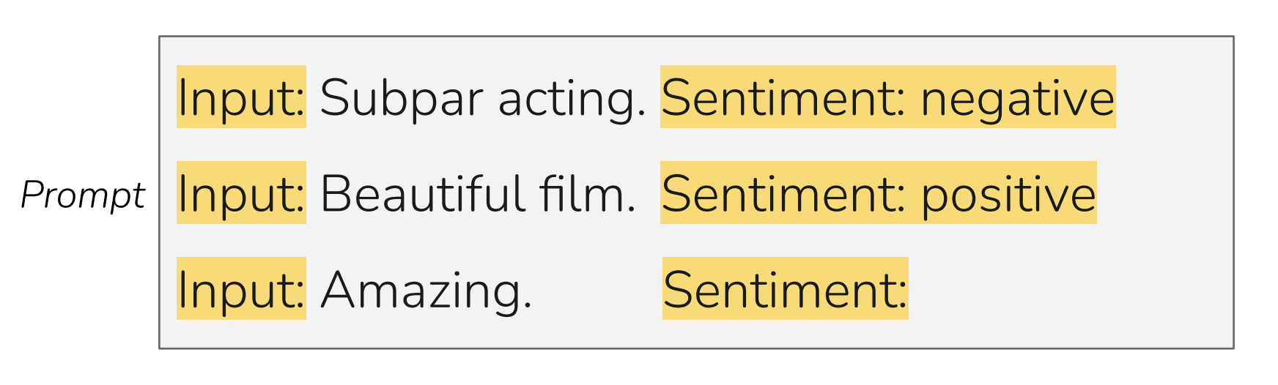
LM Prompting: Choices of Encoding
[Slide credit: Eric Wallace]

Slide 72
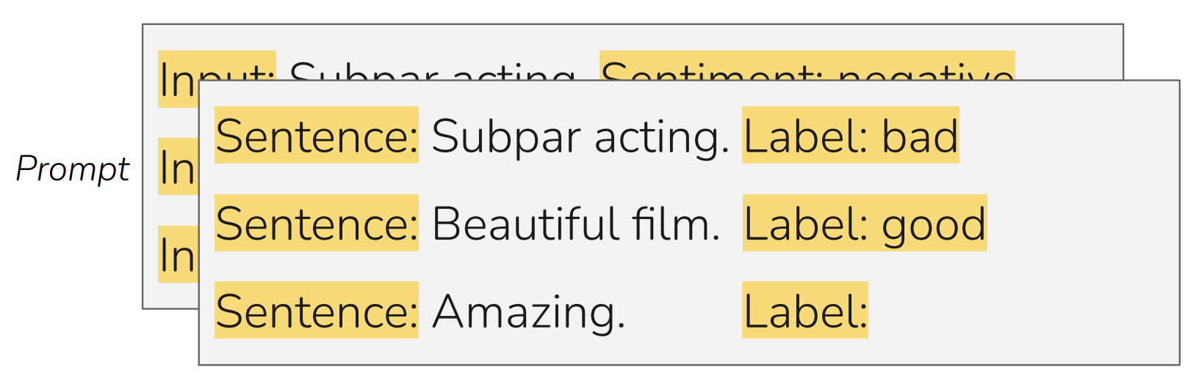
LM Prompting: Choices of Encoding
[Slide credit: Eric Wallace]

Slide 73
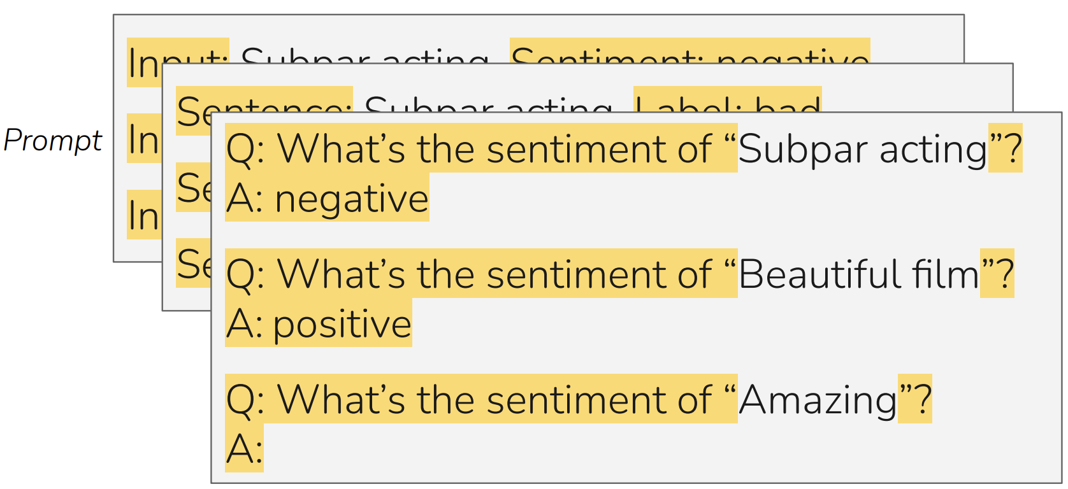
LM Prompting: Choices of Encoding
[Slide credit: Eric Wallace]

Slide 74
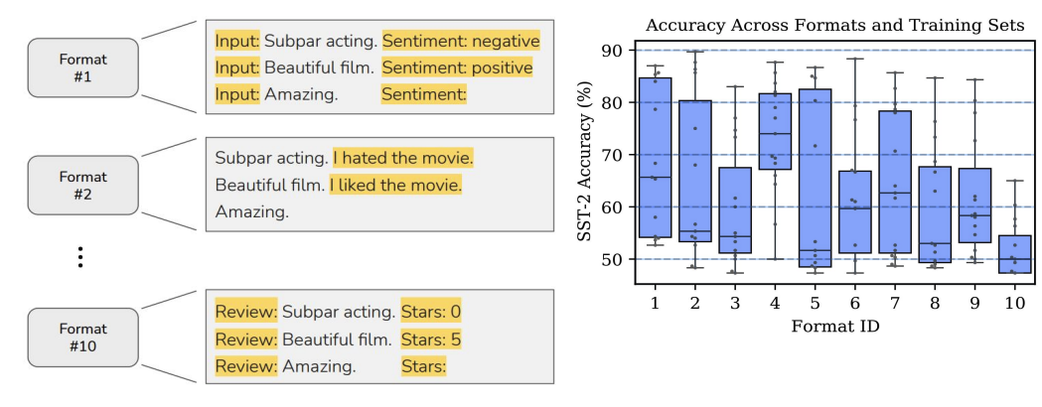
In-Context Learning: Sensitivity to Encoding
[Slide credit: Eric Wallace]
In-context learning is highly sensitive to prompt format (training sets and patterns/verbalizers)
[“Calibrate Before Use: Improving Few-Shot Performance of Language Models.” Zhao et al. 2021]

Slide 75
In-Context Learning: Sensitivity to Demo. Permutations
[Slide credit: Eric Wallace]
Training Set #1

Slide 76
In-Context Learning: Sensitivity to Demo. Permutations
[Slide credit: Eric Wallace]
Example #1
Example #2
Example #3
Example #4
Training Set #1

Slide 77
In-Context Learning: Sensitivity to Demo. Permutations
[Slide credit: Eric Wallace]
Example #1
Example #2
Example #3
Example #4
Example #2
Example #1
Example #3
Example #4
Example #4
Example #3
Example #2
Example #1
...
Prompt #1
Prompt #2
Prompt #24
All 24 Permutations
Example #1
Example #2
Example #3
Example #4
Training Set #1

Slide 78
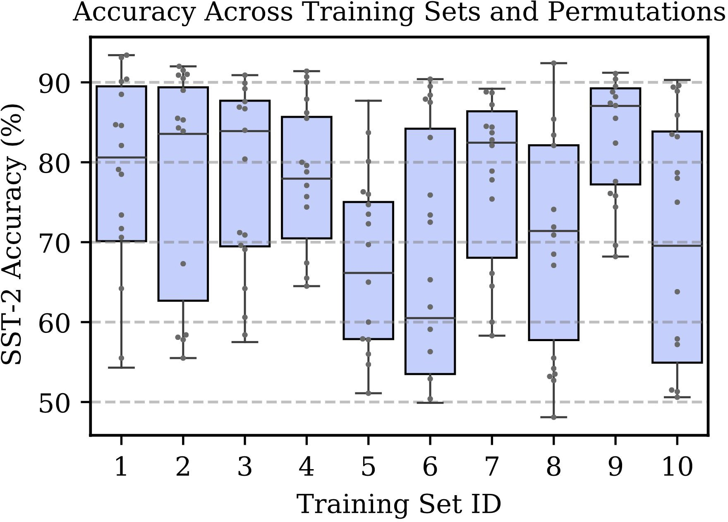
In-Context Learning: Sensitivity to Demo. Permutations
[Slide credit: Eric Wallace]
Example #1
Example #2
Example #3
Example #4
Example #2
Example #1
Example #3
Example #4
Example #4
Example #3
Example #2
Example #1
...
Prompt #1
Prompt #2
Prompt #24
All 24 Permutations
Example #1
Example #2
Example #3
Example #4
In-context learning is highly sensitive to prompt format (training sets and patterns/verbalizers)
Training Set #1
[“Calibrate Before Use: Improving Few-Shot Performance of Language Models.” Zhao et al. 2021]

Slide 79
In-Context Learning: Sensitivity to Demo. Permutations
[Slide credit: Eric Wallace]
Example #1
Example #2
Example #3
Example #4
Example #2
Example #1
Example #3
Example #4
Example #4
Example #3
Example #2
Example #1
...
Prompt #1
Prompt #2
Prompt #24
All 24 Permutations
Example #1
Example #2
Example #3
Example #4
Training Set #1
Training Set #2
[“Calibrate Before Use: Improving Few-Shot Performance of Language Models.” Zhao et al. 2021]

Slide 80
In-Context Learning: Sensitivity to Demo. Permutations
[Slide credit: Eric Wallace]
Example #1
Example #2
Example #3
Example #4
Example #2
Example #1
Example #3
Example #4
Example #4
Example #3
Example #2
Example #1
...
Prompt #1
Prompt #2
Prompt #24
All 24 Permutations
Example #1
Example #2
Example #3
Example #4
The choice of demonstrations and their order is quite important.
Training Set #1
Training Set #2
...
Training Set #10
[“Calibrate Before Use: Improving Few-Shot Performance of Language Models.” Zhao et al. 2021]

Slide 81
Sensitivity to Wording (Framing) of Prompts
Framing of prompts matters a lot.
Craft a question that requires commonsense to be answered. Based on the given context, craft a common-sense question, especially those that are LONG, INTERESTING, and COMPLEX. The goal is to write questions that are easy for humans and hard for AI machines! To create such questions, here are some suggestions: A. What may (or may not) be the plausible reason for an event? B. What may (or may not) happen before (or after, or during) an event? ...
Generate questions such that you use - ‘what may happen’, - ‘will ...?’, - ‘why might’, - ‘what may have caused’, - ‘what may be true about’,
- ‘what is probably true about’, - ‘what must’ and similar phrases in your question based on the input context.
[“Reframing Instructional Prompts to GPTk's Language.” Mishra et al. 2021.]

Slide 82
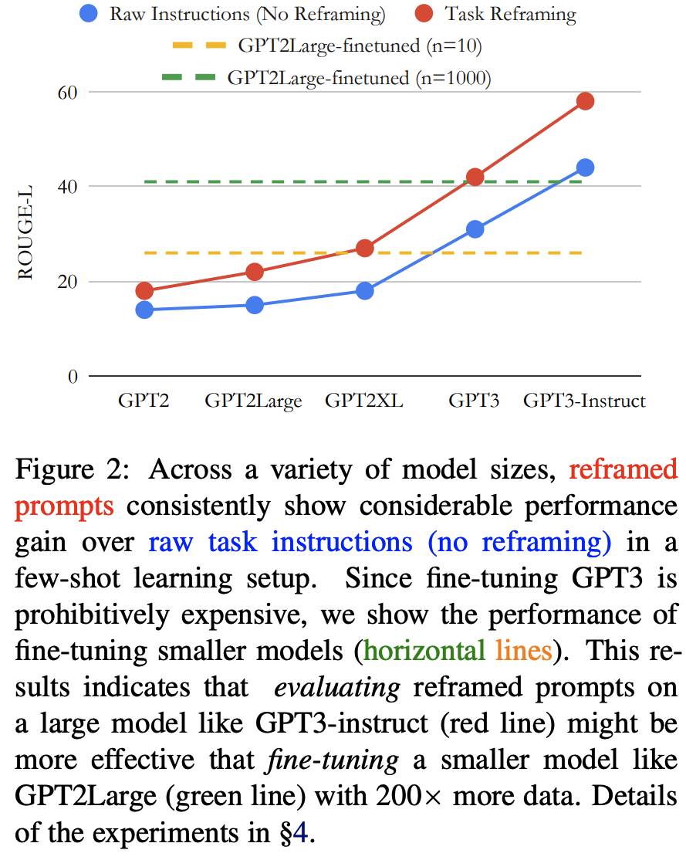
Sensitivity to Wording (Framing) of Prompts
Prompts can often be phrased in a language that are easier to be understood by language models.
Generally, it is easier for LMs to follow shorter, crisp, itemized prompts.
[“Reframing Instructional Prompts to GPTk's Language.” Mishra et al. 2021.]

Slide 83
Summary Thus Far
In-context learning:
Pre-trained LMs imitated examples provided in their context. (why??)
It turns out there is a huge variance in performance depending on the encoding.
The choice of demonstrations, their order, wording, etc.
You can treat them as hyper-parameters
You should not choose these encodings based on the test data.
Generally, you want to an encoding that makes your task similar to language modeling — closer to what is observed during pretraining.

Slide 84
What Causes These Variances?
Here we will provide several justifications …

Slide 85
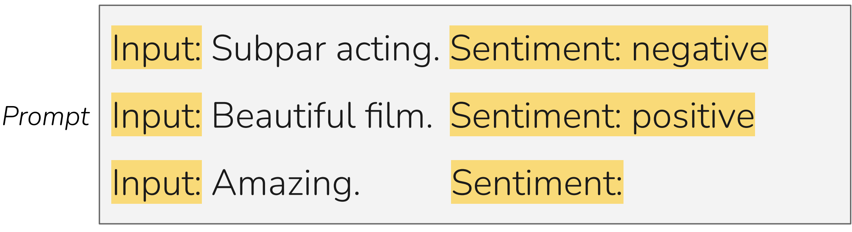
Majority Label Bias
Among 4 demonstrations, count how many are “positive”.
Then check if the model output correlates with the number of “positive” demos.

Slide 86
Majority Label Bias
Among 4 demonstrations, count how many are “positive”.
Then check if the model output correlates with the number of “positive” demos.
100
Majority label bias: frequent training answers dominate predictions.
Frequency of Positive Predictions
56
37
20
0
4/4
Positive
3/4
Positive
2/4
Positive
1/4
Positive
0/4
Positive
[“Calibrate Before Use: Improving Few-Shot Performance of Language Models.” Zhao et al. 2021]

Slide 87
Recency Bias
Check if the label of the most-recent demo biases the model output.

Slide 88
Recency Bias
Check if the label of the most-recent demo biases the model output.
90
Recency bias: examples near end of prompt dominate predictions — Explains variance across example permutations!
62
60
Frequency of Positive Predictions
12
NPPP
PNPP
PPNP
PPPN
[“Calibrate Before Use: Improving Few-Shot Performance of Language Models.” Zhao et al. 2021]

Slide 89
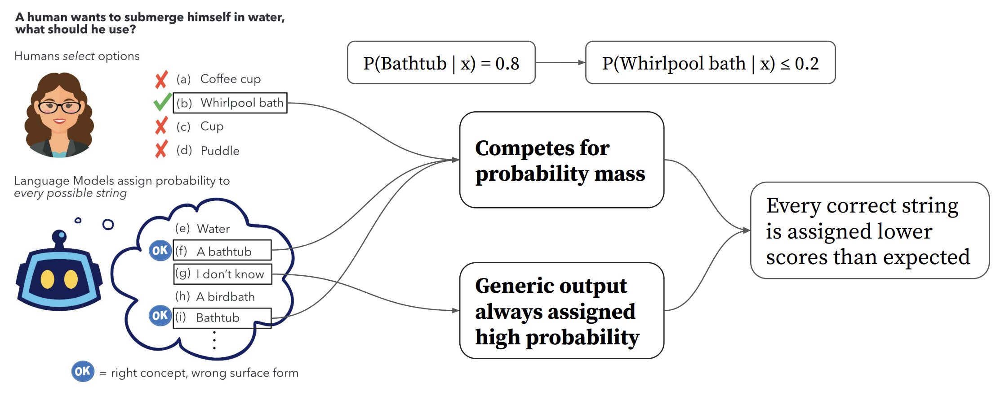

Surface Form Competition
Bonus
Surface forms are competing for probability mass (Holtzman et al 2021).
[Slide credit: Howard Yen, Vishvak Murahari]

Slide 90
Common Token Bias
Is a bias toward words that are more frequently observed in pre-training data?

Slide 91
Common Token Bias
Language Model
What topic is the following text about?
The Model T was released by Ford in 1908. Answer:
Prompt

Slide 92
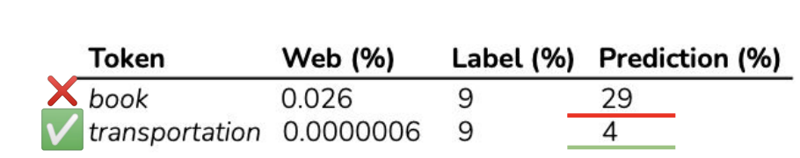
Common Token Bias
Token
Prob
Language Model
book | 0.35
transportation | 0.23
school | 0.11
village | 0.03
company | 0.02
What topic is the following text about?
The Model T was released by Ford in 1908. Answer:
Prompt
Model is biased towards predicting the incorrect frequent token "book" even when both "book" and "transportation" are equally likely labels in the dataset
Common token bias: common n-grams dominate predictions
helps explain variance across prompt formats

Slide 93



Impact of Pretraining Term Frequencies
For each task, identify relevant terms from each instance—numbers and units
Count co-occurrences of these terms in the pretraining data (term pairs or triples within a ﬁxed window)
["Impact of Pretraining Term Frequencies on Few-Shot Reasoning" Razeghi et al. 2022.]

Slide 94

Impact of Pretraining Term Frequencies
accuracy
frequency
frequency
In-context learning performance is highly correlated with
term frequencies during pretraining
["Impact of Pretraining Term Frequencies on Few-Shot Reasoning" Razeghi et al. 2022.]

Slide 95
Impact of Pretraining Term Frequencies
This may also indicate that, demonstrations do not teach a new task; instead, it is about locating an already-learned task during pretraining (Reynolds & McDonell, 2021)
But that brings up the question of how much LMs actually reason when solving these tasks.🤔 Overlooking the impact of pretraining data can be misleading in evaluation!
In-context learning performance is highly correlated with
term frequencies during pretraining
["Impact of Pretraining Term Frequencies on Few-Shot Reasoning" Razeghi et al. 2022.]

Slide 96

Impact of Input-Output Mapping
Bonus
Study the effect of randomizing labels in demonstrations.
Randomly sample a label from the correct label space
["Rethinking the Role of Demonstrations: What Makes In-Context Learning Work?" Min et al. 2022.]

Slide 97

Impact of Input-Output Mapping
Bonus
Vary number of demonstrations.
Models see a small performance drop (0–5%) with random labels
Takeaway:
Ground truth input-label mapping in the prompt is not as important as we thought!
["Rethinking the Role of Demonstrations: What Makes In-Context Learning Work?" Min et al. 2022.]

Slide 98
Summary Thus Far
In-context learning, while being fascinating, is highly unstable/brittle.
Next: why does ICL emerge?
[ACL 2022 Tutorial Beltagy, Cohan, Logan IV, Min and Singh]

Slide 99
Bonus
Why Does ICL Emerge?

Slide 100
Why Does ICL Emerge?
Bonus
We don’t know!
We have partial empirical explanations.
And some theoretical analogies.
But none of them fully explain ICL.

Slide 101

ICL Emerges Due to Parallel Structures in Pre-training
Bonus
Natural text is abundant with “parallel structure”.
Various forms of coreference
Tables
Lists
…
Hypothesis: Such parallel structure is essential for the emergence of ICL.
Parallel Structures in Pre-training Data Yield In-Context Learning, 2024

Slide 102
In-context Learning as Bayesian Inference
Bonus
(Xie et al., 2022) try to explain ICL as an implicit Bayesian inference.
Idea:
(Pre-trained LM learn to represent “concepts”, i.e. the ideas described by words.
ICL enables LMs to “locate” the learned concepts.
Can formulate this intuition as a Bayesian inference
Prior over latent “concepts”
Likelihood describes connection between text and concepts
Given an incomplete doc, use Bayes formula to infer what concept is likely it is generated from and then complete the document.
Does not explain everything.
GPT-3 can handle “unseen” concepts
$c_{1}$ $c_{2}$
latent concepts
observed documents
(e.g., demonstrations)
$d_{1}$ $d_{2}$ $d_{3}$

Slide 103

In-context Learning as Gradient Descent?
Bonus
[von Oswald et al. 2022; Akyurek et al. 2022; Dai et al. 2022, …]
Hypothesis: ICL is implicitly equivalent to SGD on in-context demonstrations
However, unclear whether these formalisms hold in reality.
[Do Pre-trained Transformers Really Learn In-context by Gradient Descent?, 2024]

Slide 104
ICL Operation: Task learning vs retrieval
Bonus
TODO

Slide 105
Summary
Bonus
In-context learning has been a promising few-shot learning approach
No gradient updates → Much easier to use large models!
Many open questions …
Understanding how/why it works,
Can we predict whether in-context learning would work on a given task or not?

Slide 106
Prompting to Solve Multi-step Problems

Slide 107
Some Problems Involve Reasoning
Q: If there are 3 cars in the parking lot and 2 more cars arrive, how many cars are in the parking lot?
Q: Take the last letters of the words in "Elon Musk" and concatenate them
Q: What home entertainment equipment requires cable?
Answer Choices: (a) radio shack
(b) substation (c) television (d) cabinet
A: The answer is nk.
A: The answer is 5
A: The answer is (c).
Arithmetic Reasoning (AR)
(+ − ×÷…)
Symbolic Reasoning (SR)
Commonsense Reasoning (CR)

Slide 108

Fine-tuning on Reasoning Problems
(Cobbe et al. 2021)
Fine-tune LMs on GSM8K (arithmetic reasoning)
One may conjecture that, to achieve >80%, one needs 100x more training data for 175B model
Another option is to increase model sizes, which is expensive.
Other than these, how else can we improve the model performance on tasks that require multi-step reasoning?

Slide 109
Vanilla ICL on Reasoning Problems
Q: “Elon Musk” A: “nk”
Q: “Bill Gates” A: “ls”
Q: “Barack Obama” A:
LM
Input

Slide 110


[Denny Zhou]

Slide 111
How about adding more examples?
[Denny Zhou]

Slide 112

[Denny Zhou]

Slide 113

Reasoning Problems via Multi-Step Prompting
Basic idea: Rather than showing input-output pairs, prompting the model such that it shows its proof steps.
Note: ideas around models that are capable of multi-step reasoning go way back.
Aristotle (deduction),
Hume (induction),
Peirce (abduction)
Lots of other works in pre-LM era
Namely, my Ph.D. thesis ☺ on multi-step reasoning in semantic representations of language!
[Reasoning-Driven Question-Answering for Natural Language Understanding]

Slide 114
CoT: Adding “thought” before “answer”
Q: “Elon Musk”
A: the last letter of "Elon" is "n". the last letter of "Musk" is "k". Concatenating "n", "k" leads to "nk". so the output is "nk". _{thought}
Q: “Bill Gates”
A: the last letter of "Bill" is "l". the last letter of "Gates" is "s". Concatenating "l", "s" leads to "ls". so the output is "ls".
Q: “Barack Obama" A:
[Denny Zhou]

Slide 115
CoT: Adding “thought” before “answer”
Q: “Elon Musk”
A: the last letter of "Elon" is "n". the last letter of "Musk" is "k". Concatenating "n", "k"
leads to "nk".
so the output is "nk".
thought
Q: “Bill Gates”
A: the last letter of "Bill" is "l". the last letter of "Gates" is "s". Concatenating "l", "s" leads to "ls". so the output is "ls".
Q: “Barack Obama"
A:
the last letter of "Barack" is "k". the last letter of "Obama" is "a". Concatenating "k", "a"
leads to "ka". so the output is "ka".
[Denny Zhou]

Slide 116

CoT: Adding “thought” before “answer”

Slide 117

CoT: Adding “thought” before “answer”
（Wei et al., 2022）
Step-by-step demonstration
Step-by-step Answer
The use of natural language to describe rationales is critical for the success of CoT.

Slide 118

CoT Prompting: Empirical Results
Setup: show demonstrations that contain the decompositions
The gains of multi-step prompting increases with scale.
Prompting achieves better perf than [smaller] models that are fine-tuned on a lot more data.
[“Chain of thought prompting elicits reasoning in large language models”, Wei et al. 2022]

Slide 119

Apply CoT to Any Task
Though each task’s demonstrations need to be “engineered” manually! ☹

Slide 120

Zero-Shot CoT
（Wei et al., 2022）
Step-by-step demonstration
Step-by-step Answer

Slide 121

Zero-Shot CoT
（Wei et al., 2022）
Step-by-step demonstration
Step-by-step Answer
（KoJima et al., 2022）
Two-stage Prompting Step-by-step Answer

Slide 122

Multi-Step Prompting: Empirical Results
Setup: show demonstrations that contain the decompositions
The gains of multi-step prompting increases with scale.
Prompting achieves better perf than [smaller] models that are fine-tuned on a lot more data.
[“Large Language Models are Zero-Shot Reasoners”, Kojima et al. 2022]

Slide 123

Multi-Step Prompting: Steps Don’t Have to Be Correct!
It is possible even with invalid demonstrations
Prompting with invalid reasoning steps can achieve over 80-90% of the performance with correct reasoning steps.
[“Towards Understanding Chain-of-Thought Prompting”, Wang et al. 2022]

Slide 124


Slide 125

Self-Consistency Leads to Improved Results

Slide 126
Self-Consistency: Cautionary tale
Long context [Adam’s paper]

Slide 127
Elements of Agentic designs
Self-consistency
ReAct
Reasoning
….
[May need to move this to “connecting too the world”].

Slide 128
Multi-Step Prompting: Parting Comments
Prompting LMs to explain their reasoning improves their performance.
However, their steps aren’t always correct.
A useful repository of annotation: https://github.com/OpenBioLink/ThoughtSource
There is much to research on here:
When do LMs over-reason or under-reason?
How do adjust the granularity of step?
How to use use given references in the proofs?
How do use external “tools” (e.g., logic, calculator, Python) in forming proofs?

Slide 129
Summary
Prompting language models is a powerful way to adapt them to our desired tasks.
We saw prompting via in-context demonstrations
We also saw various variants and extensions
They also serve as a gateway to understand the underlying dynamics inside models.
Lots of activity in this area and room for a lot of research progress.

